Slide 1
Post-Keynesian’s compensation thesis
三元悖论的理论基础是蒙代尔-弗莱明模型。根据三元悖论，在资本自由流动的固定汇率制度下，资本流动对国内利率的自动内生调整机制会导致货币当局丧失货币政策自主权。蒙代尔-弗莱明方法认为，在固定汇率制度下，货币供应量是内生的。这是因为货币存量的变化是由外汇储备的变化引起的。
蒙代尔-弗莱明的货币供应内生性与后凯恩斯主义的货币供应内生性（Godley 和 Lavoie，2007 年）完全不同。在后凯恩斯主义方法中，货币供应是由信贷驱动的，由国内经济的私营部门的需求决定。中央银行设定利率，正如中央银行现在所宣称的那样。
三元悖论在理论上与补偿论相矛盾，补偿论是后凯恩斯主义经济学家著作中常见的观点（Goodhart，1984；Lavoie，1999、2001、2021、2022；Godley 和 Lavoie，2004）。 根据补偿论，在更现实的外生利率和内生货币供应的情况下，中央银行的行为是被动的，即适应私人部门对中央银行预付款的偿还或对中央银行有息证券的需求。因此，外汇储备的任何变化都是在中央银行正常运作的情况下自愿和自动进行冲销的，而不是任何自由裁量的货币政策决定（Serrano 和 Summa，2015 年）。

Slide 2
Post-Keynesian’s compensation thesis
补偿论认为，在国际收支出现盈余的情况下，中央银行进行干预后，外汇储备的增加不会导致商业银行存款准备金的增加。中央银行国外资产的增加将通过中央银行国内资产的减少得到补偿，即中央银行持有的政府证券或向国内银行业提供的预付款减少。此外，外汇储备的增加也通过中央银行负债方政府存款的增加得到补偿。在一些国家，中央银行还向银行业出售中行票据（中国）。因此，中央银行的资产负债表是否增加并不重要，重要的是外汇储备的增加不会导致商业银行在中央银行的存款准备金增加，从而不会导致高能货币的增加。
当商业银行对中央银行负债时，补偿机制将是自动的，因为它们希望减少债务。否则，补偿机制将通过冲销过程来完成。中央银行可以出售其政府证券，或者发行央行票据，而银行会乐意购买这些票据，因为它们的收益率可能高于存款准备金的收益率。因此，即使这里定义的冲销也可以说是自动的。
补偿论的主张是，当中央银行为避免本国货币升值而购买外汇时，尽管中央银行资产负债表资产端的外汇储备增加，但并不会导致基础货币增加，反之亦然（Lavoie，1992年，第 189-192页；2001年）。

Slide 3
Post-Keynesian’s compensation thesis
我们将三元悖论与补偿论之间的三大矛盾归纳如下：
首先，根据三元悖论，在固定汇率制度下，国际收支的任何变化都会导致外汇储备的一对一变化，这与货币供应量的内生性增加有关。与此相反，补偿论认为，在固定汇率制度下，货币创造是由私营部门对银行贷款的内生需求决定的，而不是由国际收支的变化决定的。
其次，在蒙代尔-弗莱明模型中，利率是内生变量。相比之下，补偿论认为，即使在资本完全流动的固定汇率制度下，由于存在回流机制，外汇干预所产生的储备余额会自愿自动地在中央银行资产负债表的另一个项目上得到补偿，因此中央银行能够设定利率。
第三，蒙代尔-弗莱明方法忽略了资产的可替代性，即一国的资产是否可以完全替代其他国家的资产（Smithin，2002 年）。在资本完全流动和资产替代性不完全的情况（Claassen，1996 年），国内利率不一定等于国际利率。这意味着，即使资本完全流动，货币当局仍可同时维持固定的国内利率和汇率。

Slide 4
Post-Keynesian’s compensation thesis
在固定汇率制度下，没有任何机制迫使中央银行停止积累外汇储备，因为中央银行不受以本国货币计价的资产和负债表的限制。实际上，一个国家可以积累的外汇储备水平是没有限制的。此外，在资本自由流动的固定汇率制度下，提高国内利率的收缩性货币政策完全行之有效。
然而，这并不能完全排除三元悖论，即在某些情况下，固定汇率和开放资本账户可能会损害货币自主权。例如，对于一个长期存在贸易逆差的国家来说，持续的资本外流最终可能会耗尽外汇储备，中央银行将面临无法实现利率和汇率目标的选择。因此，尽管理论上货币当局可以维持固定的国内利率，但外汇储备的积累和消耗之间存在着强烈的不对称性。外汇储备的持续外流是任何中央银行都无法无限期弥补的，这将对国内货币自主权造成相关限制。
根据中国人民银行的资产负债表，资产端对私人部门的债权表示对国内金融部门的垫款，这意味着中国的银行系统在结构上对中央银行负债。因此，中国运行的是透支型经济，而不是以大量政府债务为特征的资产型经济。对于那些已经满足了所有信贷需求的商业银行来说，外汇流入会自然而然地鼓励银行利用增加的储备偿还在中国人民银行的债务。或者，商业银行将其储备换成利率更高的中央银行证券。这两种行为都会减少商业银行准备金的增加，使货币基础保持不变。因此，补偿理论的主要含义是帮助中国政府保持货币政策的自主性。

Slide 5
Post-Keynesian’s compensation thesis
对中国人民银行资产负债表的简单分析表明，1999年12月至2014年5月期间，政府存款（从1785.5亿元增至3629.4亿元）和央票发行（从0元增至7362亿元）的增加与外汇储备的增加同时出现。2014年5月之后，政府存款和央票的新发行量都随着外汇储备的下降而减少。
私营部门债权与总资产之比（APR/Assets）的变化与外汇储备的变化成反比。从1999年12 月到2014年5月，随着外汇储备的增加，该比率从0.55降至0.07。2014年5月后，随着外汇储备的下降，该比率回升至0.33。
相比之下，货币基础的变化并不显著，不足以完全解释外汇储备的变化。从1999年12月到 2014年5月，货币基础与总负债的比率（LMB/Liab.）的变化远远小于净外汇储备与总资产的比率（ALFR/Assets）的增长（从0.40 到0.83）。
从1999年12月到2006年12月，LMB/Liab.的比率从0.87下降到0.60，而 ALFR/Assets 的比率从0.40上升到0.66。私营部门债权与总资产之比的下降弥补了这一差异。同样，2014年5月之后，LMB/Liab.比率的变化方向几乎与 ALFR/Assets 比率相反。

Slide 6
THE BALANCE SHEET OF THE PBC (UNIT: BILLION YUAN)
 | 1999, Dec. | 2006, Dec. | 2014, May | 2016, Dec. | 2019, Dec.
Assets | 3534.98 | 12857.47 | 32902.32 | 34371.16 | 37113.05
Net foreign exchange reserves ALFR | 1406.14 (ALFR/Assets: 0.40) | 8436.08 (ALFR/Assets: 0.66) | 27299.86 (ALFR/Assets: 0.83) | 21942.53 (ALFR/Assets: 0.64) | 21231.73 (ALFR/Assets: 0.57)
Government securities AGS | 158.28 | 107.46 | 1531.27 | 1527.41 | 1525.02
Claims on private sector APR | 1930.85 (APR/Assets: 0.55) | 2853.35 (APR/Assets: 0.22) | 2273.57 (APR/Assets: 0.07) | 9114.45 (APR/Assets: 0.27) | 12237.23 (APR/Assets: 0.33)
Liabilities | 3534.98 | 12857.47 | 32902.32 | 34371.16 | 37113.05
Monetary base LMB (Currency Issue LCI+ Required reserves LRR) | 3062.05 (LMB/Liab.: 0.87) | 7775.78 (LMB/Liab.: 0.60) | 27392.92 (LMB/ Liab.: 0.83) | 30897.96 (LMB/ Liab.: 0.90) | 30888.29 (LMB/ Liab.: 0.83)
Central bank securities LCS | 0 | 2974.06 | 736.2 | 500 | 102
Government deposits LGD | 178.55 | 1021.07 | 3602.94 | 2506.27 | 3241.51
Other liabilities to private sector LPR | -54.14 | 971.96 | 870.66 | -730.58 | 788.45

Slide 7
Central Bank Intervention with Fixed Exchange Rates
https://saylordotorg.github.io/text_international-finance-theory-and-policy/index.html
In a floating exchange rate system, the exchange rate adjusts to maintain the supply and demand balance. In a fixed exchange rate system, it becomes the responsibility of the central bank to maintain this balance.
If, for example, the United States fixes its currency to the British pound, when there is excess demand for pounds in exchange for U.S. dollars on the private Forex, the U.S. central bank would immediately satisfy the excess demand by supplying additional pounds to the Forex market. By doing so, it can maintain a credible fixed exchange rate.
If, for example, the United States fixes its currency to the British pound, when there is excess demand for dollars in exchange for British pounds on the private Forex, the U.S. central bank would immediately satisfy the excess demand by supplying dollars to the Forex market. By doing so, it can maintain a credible fixed exchange rate.

Slide 8
Balance of Payments Deficits and Surpluses
When the central bank buys domestic currency and sells the foreign reserve currency in the private Forex, the transaction indicates a balance of payments deficit. Alternatively, when the central bank sells domestic currency and buys foreign currency in the Forex, the transaction indicates a balance of payments surplus.
Central bank transactions are recorded in an account titled official reserve transactions. It is found in the financial account of the balance of payments. If this account indicates an addition to official reserves over some period, then the country is running a balance of payments surplus. If over some period the official reserve balance is falling, then the country is running a balance of payments deficit.
Suppose a country runs a trade deficit in a fixed exchange rate system. A trade deficit means that demand for imports exceeds foreign demand for our exports. This implies that domestic demand for foreign currency (to buy imports) exceeds foreign demand for domestic currency (to buy our exports).

Slide 9
Balance of Payments Deficits and Surpluses
Assuming no additional foreign demands for domestic currency on the financial account (to keep the exchange rate fixed), the central bank would need to intervene by selling foreign currency in exchange for domestic currency. This would lead to a reduction of foreign reserves and hence a balance of payments deficit. In the absence of transactions on the financial account, to have a trade deficit and a fixed exchange rate implies a balance of payments deficit as well.
More generally, a balance of payments deficit (surplus) arises whenever there is excess demand for (supply of) foreign currency on the private Forex at the official fixed exchange rate. To satisfy the excess demand (excess supply), the central bank will automatically intervene on the Forex and sell (buy) foreign reserves. Thus by tracking sales or purchases of foreign reserves in the official reserve account, we can determine if the country has a balance of payments deficit or surplus.
It is not strictly proper to describe a country with floating exchange rates as having a balance of payment deficit or surplus. The reason is that interventions are not necessary in a floating exchange rate. In a floating system, an imbalance between supply and demand in the private Forex is relieved by a change in the exchange rate. Thus there need never be an imbalance in the balance of payments in a floating system.

Slide 10
Fiscal Policy with Fixed Exchange Rates
If the expansionary fiscal policy occurs because of an increase in government spending, then government demand for goods and services will increase. If the expansionary fiscal policy occurs due to an increase in transfer payments or a decrease in taxes, then disposable income will increase, leading to an increase in consumption demand.
In either case, aggregate demand increases. Before any adjustment occurs, the increase in aggregate demand causes aggregate demand to exceed aggregate supply, which will lead to an expansion of Y.
As Y rises, so does real money demand, causing an increase in U.S. interest rates.
With higher interest rates, the rate of return on U.S. assets rises above that in the United Kingdom and international investors increase demand for dollars (in exchange for pounds) on the private Forex.
In a floating exchange rate system this would lead to a U.S. dollar appreciation (and pound depreciation).

Slide 11
Fiscal Policy with Fixed Exchange Rates
However, because the country maintains a fixed exchange rate, excess demand for dollars on the private Forex will automatically be relieved by the U.S. Federal Reserve (or the Fed) intervention. The Fed will supply the excess dollars demanded by buying pounds in exchange for dollars at the fixed exchange rate.
The foreign currency purchases by the Fed result in an increase in the U.S. money supply.
This is because when the Fed sells dollars in the private Forex, these dollars are entering into circulation and thus become a part of the money supply, which in turn will lower interest rates back to their original level. This result is necessary to maintain the fixed exchange rate interest rate parity (IRP) condition of i$ = i£.
As Y increases in the transition, causing interest rates to rise, this rise is immediately countered with automatic Fed intervention in the Forex. Thus the exchange rate will never fall below the fixed rate. There will be pressure for the exchange rate to fall, but the Fed will always be there to relieve the pressure with its intervention.
Expansionary fiscal policy in a fixed exchange rate system will cause an increase in Y, no change in the exchange rate (of course), and a decrease in the current account balance.

Slide 12
Monetary Policy with Fixed Exchange Rates
Suppose the U.S. central bank (the Fed) decides to expand the money supply by conducting an open market operation, ceteris paribus. Ceteris paribus means that all other exogenous variables are assumed to remain at their original values. A purchase of Treasury bonds by the Fed will lead to an increase in the dollar money supply.
The money supply increase puts upward pressure on the exchange rate in the following way. First, a money supply increase causes a reduction in U.S. interest rates. This in turn reduces the rate of return on U.S. assets below the rate of return on similar assets in Britain. Thus international investors will begin to demand more pounds in exchange for dollars on the private Forex to take advantage of the relatively higher RoR of British assets.
In a floating exchange system, excess demand for pounds would cause the pound to appreciate and the dollar to depreciate.
However, because the country maintains a fixed exchange rate, excess demand for pounds on the private Forex will automatically be relieved by Fed intervention. The Fed will supply the excess pounds demanded by selling reserves of pounds in exchange for dollars at the fixed exchange rate.

Slide 13
Monetary Policy with Fixed Exchange Rates
Fed sales of foreign currency result in a reduction in the U.S. money supply. This is because when the Fed buys dollars in the private Forex, it is taking those dollars out of circulation and thus out of the money supply.
This implies that the money supply reduction due to Forex intervention will exactly offset the money supply expansion induced by the original open market operation.
Thus the money supply will temporarily rise but then will fall back to its original level.
Maintaining the money supply at the same level also assures that interest rate parity is maintained.
Thus after final adjustment occurs, there are no effects from expansionary monetary policy in a fixed exchange rate system. The exchange rate will not change and there will be no effect on equilibrium Y. Also, since the economy returns to the original equilibrium, there is also no effect on the current account balance.

Slide 14
Monetary Policy with Fixed Exchange Rates
This result indicates that monetary policy is ineffective in influencing the economy in a fixed exchange rate system.
In contrast, in a floating exchange rate system, monetary policy can either raise or lower Y, at least in the short run. Thus monetary policy has some effectiveness in a floating system, and central bank authorities can adjust policy to affect macroeconomic conditions within their economy. For example, if the economy is growing only sluggishly, or perhaps is contracting, the central bank can raise the money supply to help spur an expansion of Y, if the economy has a floating exchange rate.
However, with a fixed exchange rate, the central bank no longer has this ability. This explains why countries lose monetary autonomy (or independence) with a fixed exchange rate. The central bank can no longer have any influence over the interest rate, exchange rate, or the level of Y.
There are no effects from expansionary or contractionary monetary policy in a fixed exchange rate system. The exchange rate will not change, there will be no effect on equilibrium Y, and there will be no effect on the current account balance.

Slide 15
Fiscal Policy with Floating Exchange Rates
If the expansionary fiscal policy occurs because of an increase in government spending, then government demand for G&S will increase. If the expansionary fiscal policy occurs due to an increase in transfer payments or a decrease in taxes, then disposable income will increase, leading to an increase in consumption demand. In either case aggregate demand increases, so does Y.
As Y rises, so does real money demand, causing an increase in U.S. interest rates.
With higher interest rates, the rate of return on U.S. assets rises above that in the United Kingdom and international investors shift funds back to the United States, resulting in a dollar appreciation (pound depreciation)—that is, a decrease in the exchange rate E$/£.
This moves the economy downward. The adjustment in the asset market will occur quickly after the change in interest rates.
Both an increase in Y and a dollar appreciation cause decreases in current account balance.
Expansionary fiscal policy causes an increase in Y, an appreciation of the currency, and a decrease in the current account balance in a floating exchange rate system.

Slide 16
Monetary Policy with Floating Exchange Rates
When the money supply increases, real money supply will exceed real money demand in the economy. Since households and businesses hold more money than they would like, at current interest rates, they begin to convert liquid money assets into less-liquid nonmoney assets. This raises the supply of long-term deposits and the amount of funds available for banks to loan.
More money to lend will lower average U.S. interest rates, which in turn will result in a lower U.S. rate of return in the Forex market.
Since RoR$ < ROR£ now, there will be an immediate increase in the demand for foreign British currency, thus causing an appreciation of the pound and a depreciation of the U.S. dollar. Thus the exchange rate (E$/£) rises.
This implies foreign goods and services are relatively more expensive while U.S. G&S are relatively cheaper.
This will raise demand for U.S. exports, curtail demand for U.S. imports, and result in an increase in current account and, thereby, aggregate demand and Y.

Slide 17
Monetary Policy with Floating Exchange Rates
As Y rises, so does real money demand, causing an increase in U.S. interest rates.
With higher interest rates, the rate of return on U.S. assets rises above that in the United Kingdom, and international investors shift funds back to the United States, resulting in a dollar appreciation (pound depreciation)—that is, a decrease in the exchange rate (E$/£).
The U.S. expansionary monetary policy causes an increase in Y, a depreciation of the U.S. dollar, and an increase in the current account balance in a floating exchange rate system

Slide 18
The compensation thesis
The claim of the compensation thesis is that purchases of foreign currency by the central bank, so as to avoid the appreciation of the domestic currency, do not lead to an increase in the monetary base despite the increase in foreign exchange reserves on the asset side of the central bank balance sheet, and vice versa when the central bank sells foreign currency (Lavoie 1992, pp. 189-192; 2001).
The increase in the foreign assets of the central bank will be compensated by a decrease in the domestic assets of the central bank - namely a fall in the government securities held by the central bank or in the advances made to the domestic banking sector. More recently, the increase in foreign exchange reserves has also been compensated by an increase in government deposits on the liability side of the central bank. In some countries, central banks have also sold central bank bills to the banking sector.
Thus, whether there is or not an increase in the balance sheet of the central bank does not matter: what happens is that an increase in foreign exchange reserves does not lead to an increase in the reserves held by banks at the central bank, and thus to no increase in high-powered money.

Slide 19
The compensation thesis
When commercial banks are indebted towards the central bank, compensation will be automatic, since they will wish to reduce their debt.
Otherwise, one will tend to speak of sterilization, as the central bank will either sell its government securities or issue central bank bills which banks will gladly acquire, since these are likely to carry a higher yield than that of reserves. Thus, even sterilization as defined here can be said to be automatic.
All of this is based on the standard post-Keynesian assumption that the supply of credit is demand-led, meaning that banks will provide all the loans that they deem to be creditworthy.
This is also coherent with the position advocated by modern monetary theory (MMT), according to which the expenditures of central government financed out of its account at the central bank must be ‘neutralised’, as they increase the reserves of banks.

Slide 20
The compensation thesis
Two objections to the validity of the compensation thesis can or have been raised. As recalled earlier, one implication of the compensation view is that central banks are able to control the overnight interest rate. Indeed, the justification for compensation when it is not automatic (when the central bank takes sterilization actions) is that the central bank has a target overnight rate and hence needs to proceed to sterilization or compensation if it wishes to keep the actual overnight rate on target.
But then a question arises: whereas it seems clear that central banks can control the short-term rate of interest as well as the size and composition of their balance sheets, what about long-term rates?
Nearly all stock-flow consistent models assessing the interdependence between two countries in a fixed-exchange rate regime do so by dealing only with one type of security per country — a short-term government security. What if there are two sorts of securities? While it may be possible to design a model where central banks can manage both the short-term rate and the low-risk long-term interest rate, as was done in a number of countries before 1951 and as Japan has done since 2015 through its policy of yield curve control, in general one would expect that the long-term rate would respond to the liquidity preference of agents and hence to the laws of supply and demand.

Slide 21
The compensation thesis
Indeed, such a two-country stock-flow consistent model yielding precisely these implications already exists. It can be found in the working paper of Wynne Godley (1999), which presented three versions of a stock-flow consistent model of a two-country economy.
In the second version, each government issues two securities, bills and bonds, and one of the central banks intervenes in the foreign exchange market so as to keep fixed its exchange rate. In this case, unless asset holders react strongly to interest rate differentials, while the short rate (the bill rate) can be kept at a constant level, the long-term rate (the bond rate) will rise progressively in the country where there occurs a balance-of-payment deficit. Symmetrically, in the country running a balance-of-payment surplus, the bond rate would progressively fall, unless fiscal policy adjusts and becomes more expansionary.
Thus, if we are to believe this version of Godley’s model, there is room for skepticism about the neutralizing impact of sterilization or compensation on interest rates, as Taylor (2008) contended. Short-term interest rates will remain under the control of the central bank but this, in general, will not be the case of long rates. Note that this has nothing to do with an excess amount of money, as all these stock-flow consistent models are built on the assumption that the supply of money is endogenous and responds to the demand for money.

Slide 22
The compensation thesis
Another argument against the standard understanding of compensation or sterilisation has been put forth by Bleaney and Devadas (2017).While they recognise that the stock of high-powered money will remain under the control of central banks despite the existence of a fixed-exchange rate regime, they argue that all the previous empirical studies of the effects of sterilisation ignore the relationship between balance-of-payment surpluses and the evolution of the broad money supply (М2 or М3, rather than M0).
As they believe that there is a causal and strong relationship between broad money and prices, they argue that what ought to be tested is whether there also occurs an implicit sterilisation of broad money. Despite taking into account changes in real economic activity, they find that ‘unlike reserve money, broad money is to a significant degree not sterilised against foreign exchange intervention’ and conclude that ‘the accumulation of foreign exchange reserves feeds through significantly to broad money in the long run, which raises concerns about inflationary pressures and asset price bubbles’ (Bleaney and Devadas 2017, p. 262). What we have here is another version of the ‘imported inflation’ thesis, popular in the 1960s, which was said to countries in a fixed-exchange rate regime running trade balance surpluses.

Slide 23
The compensation thesis
This objection to the compensation thesis based on the effects over broad money is not new and was dealt with from the very beginning by a number of French economists in the 1970s.
Looking at the case of a surplus trade balance, Berger (1972b, p. 175) argued that exporters would first use the proceeds of their sales and thus their newly-acquired money balances to reduce their debt towards the banking system - a case of deleveraging and a version of the reflux principle advocated by the Banking School, Nicholas Kaldor and Joan Robinson. Thus, both the banks and the exporter would reduce the advances previously taken.
Berger further noted that, historically, he had indeed observed an increase in the stock of broad money in periods of balance-of-payment surpluses, but this did not necessarily imply a causal effect on economic activity or price inflation.
In the case of a capital account surplus due to short-term capital flows, Berger claimed that they would allow the government or private firms to diminish their debt towards the domestic banking system.
Coulbois (1979, pp. 282—284) provides similar counter-arguments to this imported inflation thesis.

Slide 24
US-China two-country stock flow consistent model
First, we present a model of an open economy under a regime of fixed exchange rates, with no private international capital flows. It can be interpreted as a small open economy.
In addition, this model will show that reductions or increases in foreign exchange reserves, as a result of foreign exchange interventions by the central bank to keep the exchange rate fixed, have no effect on the money supply. In other words, foreign exchange interventions by central banks are "automatically" sterilize.
The way in which this model works will prepare the ground for a more complex model, presented in the second part, in which the exchange rate is determined by demand and supply for internationally tradable financial assets and in which changes in the exchange rate feed back to help determine trade and all other flows as sequences in real time.
It will also be shown how this more complex model can be extended to a fixed exchange regime.

Slide 25
US-China two-country stock flow consistent model
It may be tempting to compare the present analysis to the standard Mundell-Fleming models (the IS-LM-BP models).
But comparisons are hard to come by. Mundell (1963) assumes perfect capital mobility and perfect asset substitutability, whereas we assume only the former so that capital flows generated by differing rates of return cannot go on forever.
Mundell (ibid.) and Fleming (1962), along with their textbook representations, assume that monetary policy is best represented by purchases and sales of securities on the open market, whereas we assume that interest rate targeting best represents monetary policy.
Finally, we make explicit the interdependence of all variables within a stock-flow approach, whereas the standard textbook approach does not.

Slide 26
US-China two-country stock flow consistent model
The economy is assumed to comprise firms, households, a foreign sector, and a government with a separate central bank.
Imports are determined by the import propensity and income.
Consumption each period is determined by disposable income and the stock of wealth inherited from the previous period.
Investment is set aside because its inclusion in our framework requires a complete yet simplified representation of the way in which investment is financed and a large number of additional equations. Its inclusion would not change our essential conclusions because net investment would need to be equal to zero once a long-run equilibrium has been reached, unless we moved the analysis to growth models.

Slide 27
US-China two-country stock flow consistent model
Transaction and balance sheet matrices of a simplified economy with capital controls
Flows per period
Sectors | Households | Firms | Central Bank | Government | Foreign | Sum
National accounts |  |  |  |  |  | 0
Consumption | -C | +C |  |  |  | 0
Government |  | +G |  | -G |  | 0
Exports |  | +X |  |  | -X | 0
Imports |  | -IM |  |  | +IM | 0
Total income/output | +Y | -Y |  |  |  | 0
Taxes | -T |  |  | +T |  | 0
Flow of funds |  |  |  |  |  | 0
Changes in |  |  |  |  |  | 0
T-bills | -ΔBp |  | -ΔBcb | +ΔB |  | 0
Cash | -ΔH |  | +ΔH |  |  | 0
Foreign exchange reserves |  |  | -ΔR |  | +ΔR | 0
Sum | 0 | 0 | 0 | 0 | 0 | 0
Changes in |  |  |  |  |  | 0
Total wealth/debt | +ΔV | 0 | 0 | -ΔB | -ΔR | 0
Balance sheets(stocks) at end of period |  |  |  |  |  | 0
T-bills | +Bp |  | +Bcb | -B |  | 0
Cash | +H |  | -H |  |  | 0
Foreign exchange reserves |  |  | +R |  |  | 0
Sum = Total wealth/debt | +V | 0 | 0 | -B | -R | 0

Slide 28
US-China two-country stock flow consistent model
Our simple model is recursive, with national account flows being determined without considering flows of funds and portfolio choices. How does the rest of the system fit together?
We now move on to the financial side of the model. Saving each period, together with the opening stock of wealth, creates a new end-period stock of wealth, which the personal sector allocates between cash and Treasury bills in a proportion determined by the exogenous interest rate.
Assuming for simplicity no transactions demand for cash.
The coefficients in the array are constrained according to Tobinesque adding-up principles so that the sum of constants is equal to one, and the sum of the other column is zero.
The government sells (issues) additional Treasury bills to cover any deficit.
We assume, in line with standard Post Keynesian theories, and in line with the new "consensus view" espoused by some New Keynesians, that the interest rate is set and administered by the central bank. With constant interest rates, it has to be the case that the central bank will exchange Treasury bills for cash on any scale whatever in response to demand.

Slide 29
US-China two-country stock flow consistent model
We assume that the Bank will hold any amount of Treasury bills that the private sector is unwilling to hold at the target rate of interest.
Thus, the Treasury and the monetary authorities do not decide what proportion of the public debt ought to be "monetized," if we dare use the wording of mainstream authors. This proportion is determined endogenously by the portfolio decisions of the private sector and the evolution of the external balance, once the target rate of interest has been set by the central bank.
The central bank holds two kinds of assets, namely, domestic and foreign Treasury bills, the latter being the foreign reserves of the domestic economy. Any imbalance in trade (because there are no capital flows) implies an equivalent change in the stock of foreign reserves.
The supply of cash is implied by the Bank's balance sheet.
There is neither a need nor a place for an equation (the "redundant" equation) to make the demand for money equal to the supply. The money stock is thus comprehensively endogenous; it is what the central bank finds itself supplying, given the demand for money.

Slide 30
US-China two-country stock flow consistent model
A major feature of this model is that there is nothing in it, no self-correcting mechanism, to make exports equal to imports. In general, once the steady-state level of income has been reached, trade will still be unbalanced, which implies that this solution is instead a quasi steady state, because some stocks will still be changing, namely, the central bank stock of foreign reserves and the stock of government debt.
We give a numerical example of what would happen, according to our simple model, if exports were to jump by $5. In the first period, the balance of trade would improve by $3, and the budget balance by $1.6.
Our SFC model shows how "sterilization" would occur automatically and endogenously, being the consequence of the central bank decision to keep interest rates at a given level, which is how central banks function in the real world. The reduction in the holdings of Treasury bills by the central bank compensates for the increase in foreign reserves that is not accompanied by an increase in money demand.

Slide 31
US-China two-country stock flow consistent model
In a (quasi) steady state, a trade deficit will be accompanied by an equivalent budget deficit, and, conversely, that a trade surplus will be associated with a budget surplus.
In the case of a trade deficit, as long as private capital flows are not allowed, there are no means to finance a trade deficit after the reserves of the central bank have become exhausted. A possible response, when reserves run out, will be to restrict demand, using fiscal policy, to the point where exports equal imports, IM- X = 0. In this case, we end up with the super steady state where all stocks as well as all flows are constant.
The situation is, however, different when countries are running trade surpluses.
Take the case of China with its exchange rate fixed to the U.S. dollar and its huge balance-of-payments surplus. The country is accumulating enormous additions to its foreign reserves. The People's Bank of China is still able to control interest rates, the economy is not being flooded with liquidity, and hence there is no inherent corrective mechanism, save continued expansion, that would bring about a balanced trade account.

Slide 32
US-China two-country stock flow consistent model
The Chinese economy can continue to run balance-of-payments surpluses forever, if its government leaders are happy to accumulate U.S. financial assets.
There is no mechanism, neither a price mechanism nor a quantity mechanism, that will force the surplus countries to converge toward a balanced current account.
The Chinese financial system being an "overdraft" system, commercial banks are indebted to the central bank.
When the country is running a balance-of-payments surplus, commercial banks can use their foreign currency holdings to reduce their indebtedness vis-a-vis the central bank.
Sterilization thus occurs in large part at the initiative of the commercial bank sector-sterilization is endogenous.

Slide 33
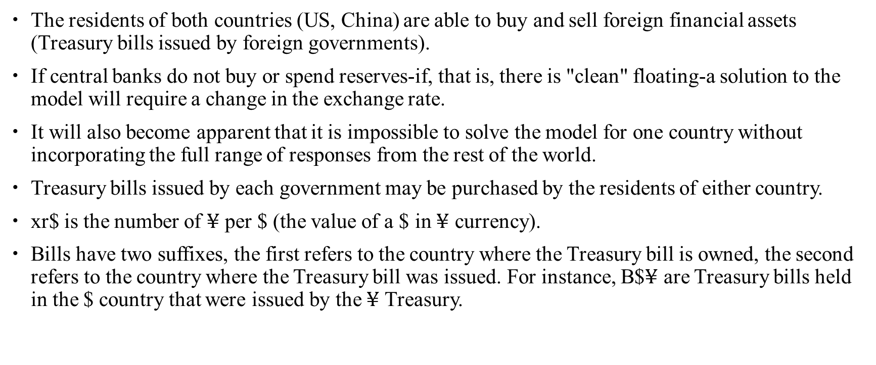
US-China two-country stock flow consistent model
The residents of both countries (US, China) are able to buy and sell foreign financial assets (Treasury bills issued by foreign governments).
If central banks do not buy or spend reserves-if, that is, there is "clean" floating-a solution to the model will require a change in the exchange rate.
It will also become apparent that it is impossible to solve the model for one country without incorporating the full range of responses from the rest of the world.
Treasury bills issued by each government may be purchased by the residents of either country.
xr$ is the number of $¥$ per $ (the value of a $ in $¥$ currency).
Bills have two suffixes, the first refers to the country where the Treasury bill is owned, the second refers to the country where the Treasury bill was issued. For instance, B$$¥$ are Treasury bills held in the $ country that were issued by the $¥$ Treasury.

Slide 34
Transaction matrix in US-China two-country economy

Slide 35
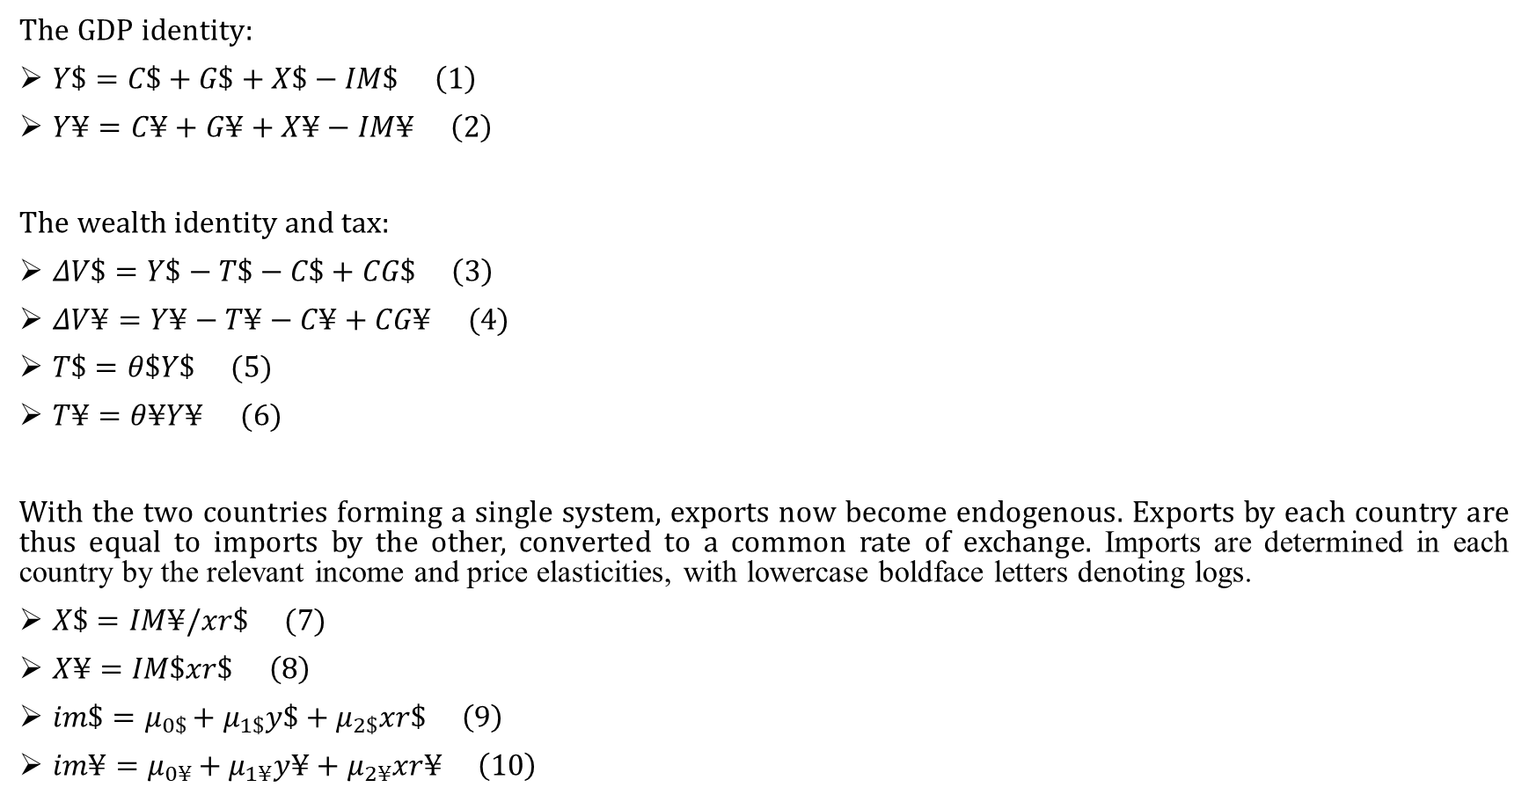
Behavior functions
The GDP identity:
$Y\$=C\$+G\$+X\$−IM\$ \left(1\right)$
$Y¥=C¥+G¥+X¥−IM¥ \left(2\right)$
The wealth identity and tax:
$ΔV\$=Y\$−T\$−C\$+CG\$ \left(3\right)$
$ΔV¥=Y¥−T¥−C¥+CG¥ (4)$
$T\$=θ\$Y\$ (5)$
$T¥=θ¥Y¥ (6)$
With the two countries forming a single system, exports now become endogenous. Exports by each country are thus equal to imports by the other, converted to a common rate of exchange. Imports are determined in each country by the relevant income and price elasticities, with lowercase boldface letters denoting logs.
$X\$=IM¥/xr\$ (7)$
$X¥=IM\$xr\$ \left(8\right)$
$im\$=μ_{0\$}+μ_{1\$}y\$+μ_{2\$}xr\$ \left(9\right)$
$im¥=μ_{0¥}+μ_{1¥}y¥+μ_{2¥}xr¥ \left(10\right)$

Slide 36
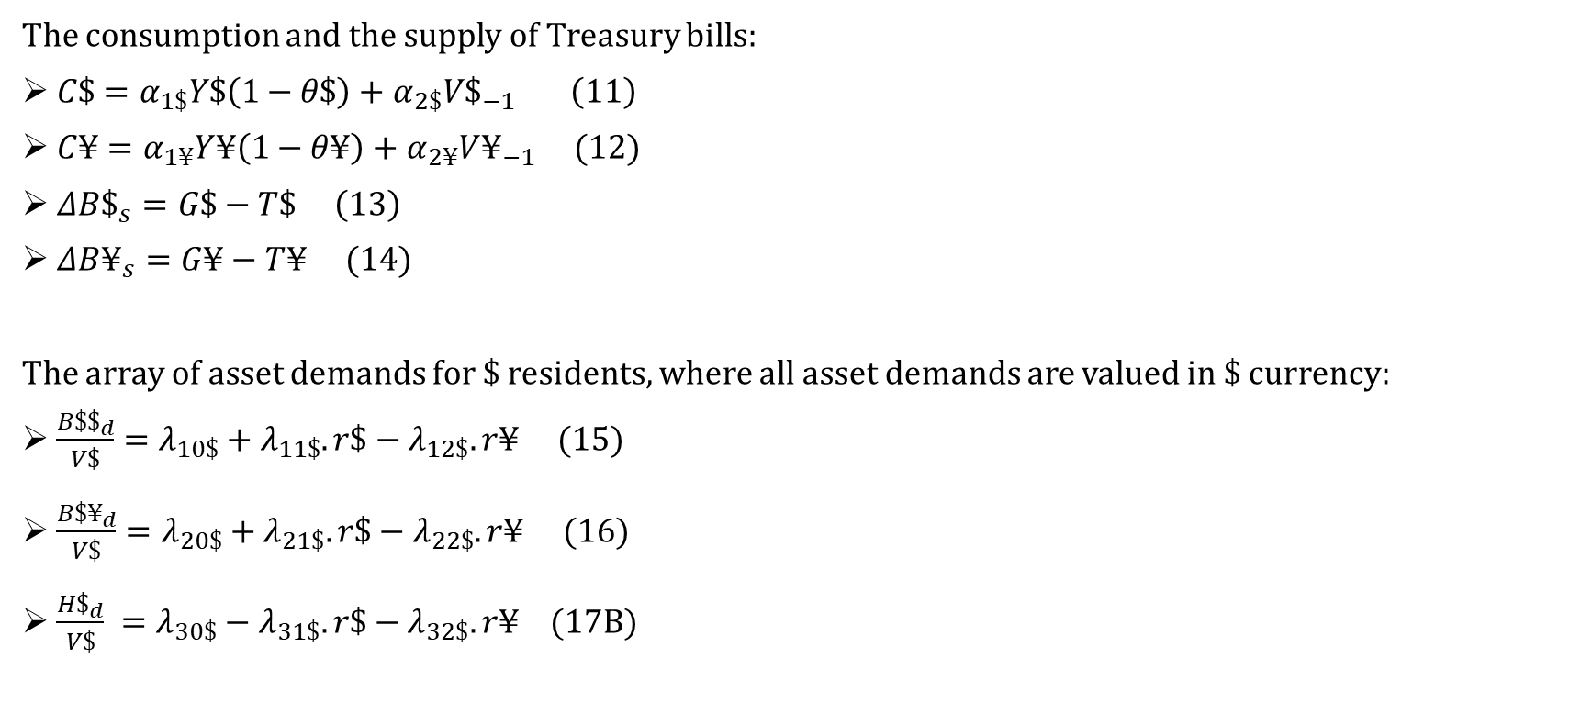
Behavior functions
The consumption and the supply of Treasury bills:
$C\$=α_{1\$}Y\$\left(1−θ\$\right)+α_{2\$}V\$_{−1} \left(11\right)$
$C¥=α_{1¥}Y¥\left(1−θ¥\right)+α_{2¥}V¥_{−1} (12)$
$ΔB\$_{s}=G\$−T\$ \left(13\right)$
$ΔB¥_{s}=G¥−T¥ (14)$
The array of asset demands for $ residents, where all asset demands are valued in $ currency:
$\begin{aligned}\frac{B\$\$_{d}}{V\$}=λ_{10\$}+λ_{11\$}.r\$−λ_{12\$}.r¥ (15)\end{aligned}$
$\begin{aligned}\frac{B\$¥_{d}}{V\$}=λ_{20\$}+λ_{21\$}.r\$−λ_{22\$}.r¥ (16)\end{aligned}$
$\frac{H\$_{d}}{V\$} =λ_{30\$}−λ_{31\$}.r\$−λ_{32\$}.r¥ (17B)$

Slide 37
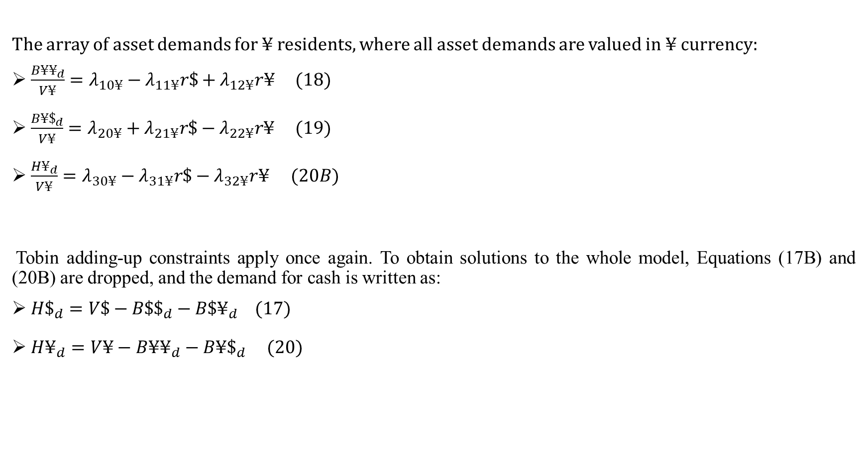
Behavior functions
The array of asset demands for $¥$ residents, where all asset demands are valued in ¥ currency:
$\frac{B¥¥_{d}}{V¥}=λ_{10¥}−λ_{11¥}r\$+λ_{12¥}r¥ (18)$
$\frac{B¥\$_{d}}{V¥}=λ_{20¥}+λ_{21¥}r\$−λ_{22¥}r¥ (19)$
$\frac{H¥_{d}}{V¥}=λ_{30¥}−λ_{31¥}r\$−λ_{32¥}r¥$ $(20B)$
Tobin adding-up constraints apply once again. To obtain solutions to the whole model, Equations (17B) and (20B) are dropped, and the demand for cash is written as:
$H\$_{d}=V\$−B\$\$_{d}−B\$¥_{d} (17)$
$H¥_{d}=V¥−B¥¥_{d}−B¥\$_{d} (20)$

Slide 38
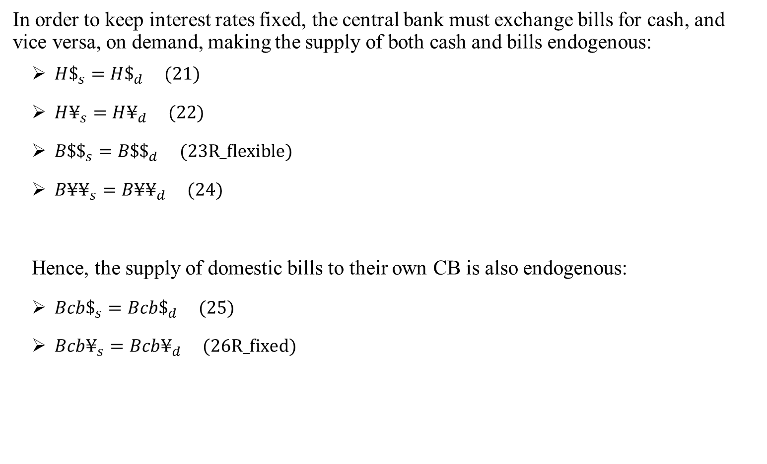
Behavior functions
In order to keep interest rates fixed, the central bank must exchange bills for cash, and vice versa, on demand, making the supply of both cash and bills endogenous:
$H\$_{s}=H\$_{d} (21)$
$H¥_{s}=H¥_{d} (22)$
$B\$\$_{s}=B\$\$_{d} (23R_flexible)$
$B¥¥_{s}=B¥¥_{d} (24)$
Hence, the supply of domestic bills to their own CB is also endogenous:
$Bcb\$_{s}=Bcb\$_{d} (25)$
$Bcb¥_{s}=Bcb¥_{d} (26R_fixed)$

Slide 39
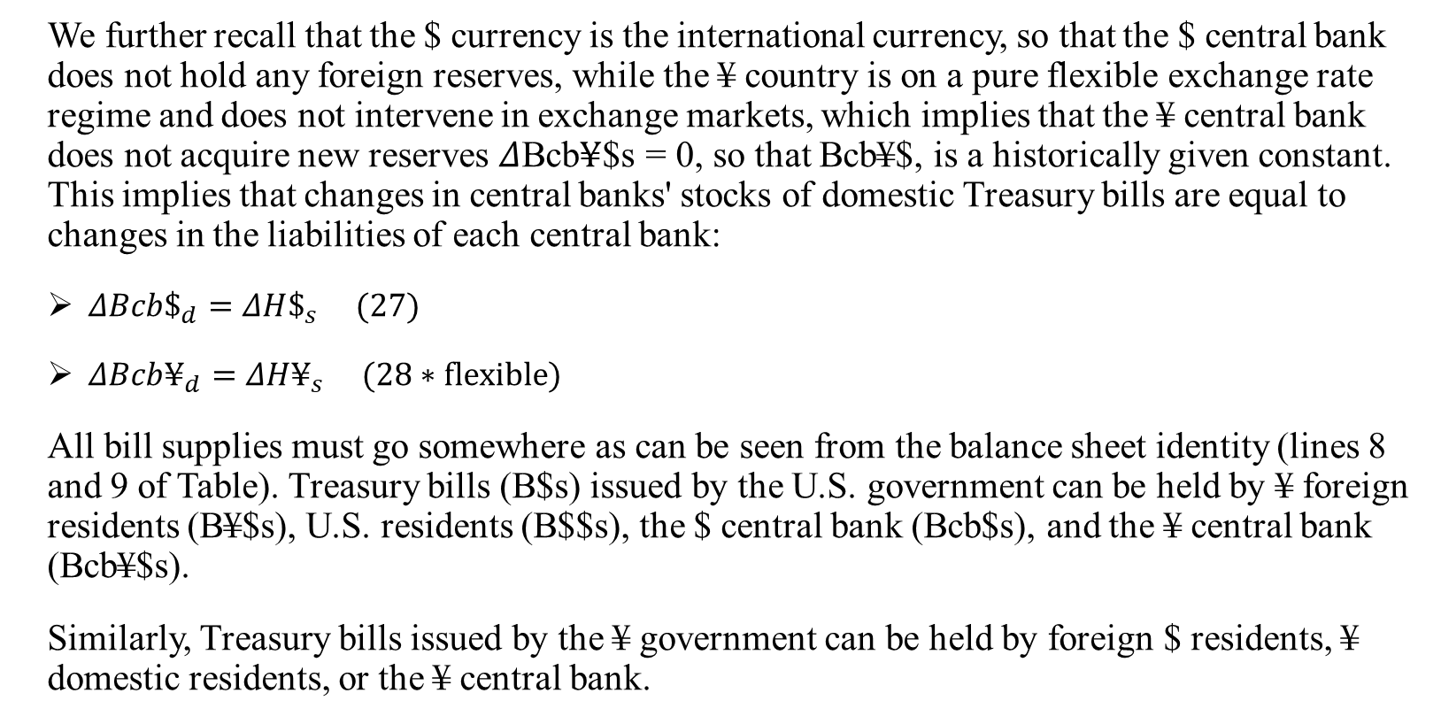
Behavior functions
We further recall that the $ currency is the international currency, so that the $ central bank does not hold any foreign reserves, while the ¥ country is on a pure flexible exchange rate regime and does not intervene in exchange markets, which implies that the ¥ central bank does not acquire new reserves $Δ$Bcb$¥$$s = 0, so that Bcb¥$, is a historically given constant. This implies that changes in central banks' stocks of domestic Treasury bills are equal to changes in the liabilities of each central bank:
$ΔBcb\$_{d}=ΔH\$_{s} (27)$
$ΔBcb¥_{d}=ΔH¥_{s} (28∗flexible)$
All bill supplies must go somewhere as can be seen from the balance sheet identity (lines 8 and 9 of Table). Treasury bills (B$s) issued by the U.S. government can be held by ¥ foreign residents (B¥$s), U.S. residents (B$$s), the $ central bank (Bcb$s), and the ¥ central bank (Bcb¥$s).
Similarly, Treasury bills issued by the ¥ government can be held by foreign $ residents, ¥ domestic residents, or the ¥ central bank.

Slide 40
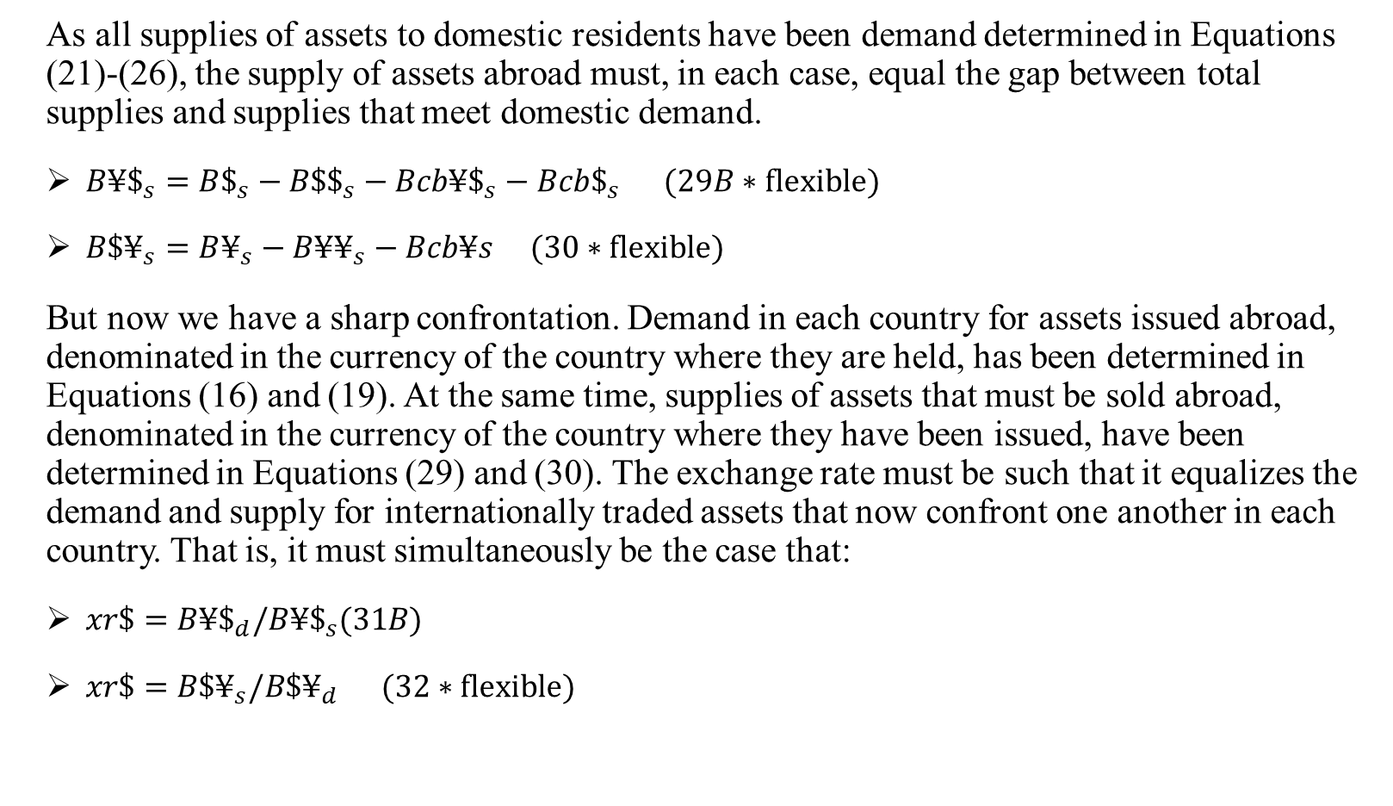
Behavior functions
As all supplies of assets to domestic residents have been demand determined in Equations (21)-(26), the supply of assets abroad must, in each case, equal the gap between total supplies and supplies that meet domestic demand.
$B¥\$_{s}=B\$_{s}−B\$\$_{s}−Bcb¥\$_{s}−Bcb\$_{s} (29B∗flexible)$
$B\$¥_{s}=B¥_{s}−B¥¥_{s}−Bcb¥s (30∗flexible)$
But now we have a sharp confrontation. Demand in each country for assets issued abroad, denominated in the currency of the country where they are held, has been determined in Equations (16) and (19). At the same time, supplies of assets that must be sold abroad, denominated in the currency of the country where they have been issued, have been determined in Equations (29) and (30). The exchange rate must be such that it equalizes the demand and supply for internationally traded assets that now confront one another in each country. That is, it must simultaneously be the case that:
$xr\$=B¥\$_{d}/B¥\$_{s}(31B)$
$xr\$=B\$¥_{s}/B\$¥_{d} (32∗flexible)$

Slide 41
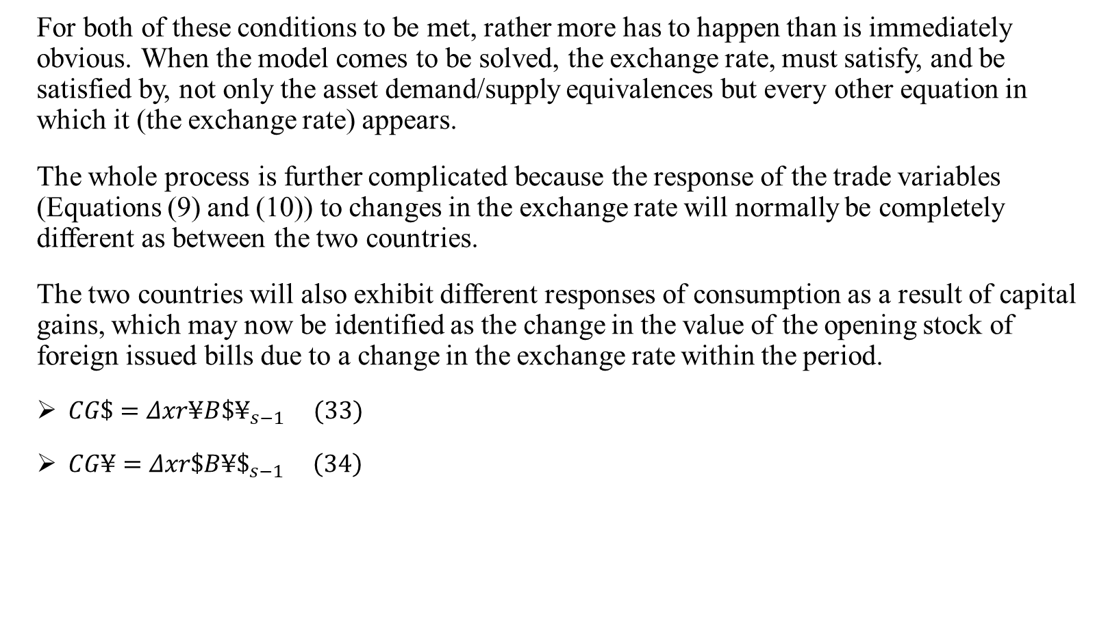
Behavior functions
For both of these conditions to be met, rather more has to happen than is immediately obvious. When the model comes to be solved, the exchange rate, must satisfy, and be satisfied by, not only the asset demand/supply equivalences but every other equation in which it (the exchange rate) appears.
The whole process is further complicated because the response of the trade variables (Equations (9) and (10)) to changes in the exchange rate will normally be completely different as between the two countries.
The two countries will also exhibit different responses of consumption as a result of capital gains, which may now be identified as the change in the value of the opening stock of foreign issued bills due to a change in the exchange rate within the period.
$CG\$=Δxr¥B{\$¥}_{s−1} (33)$
$CG¥=Δxr\$B¥\$_{s−1} \left(34\right)$

Slide 42
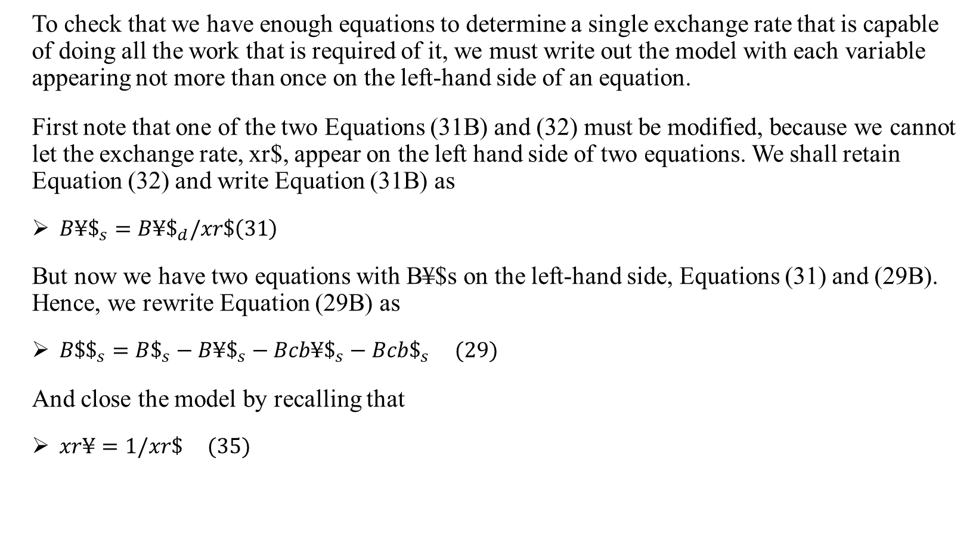
Behavior functions
To check that we have enough equations to determine a single exchange rate that is capable of doing all the work that is required of it, we must write out the model with each variable appearing not more than once on the left-hand side of an equation.
First note that one of the two Equations (31B) and (32) must be modified, because we cannot let the exchange rate, xr$, appear on the left hand side of two equations. We shall retain Equation (32) and write Equation (31B) as
$B¥\$_{s}=B¥\$_{d}/xr\$\left(31\right)$
But now we have two equations with B¥$s on the left-hand side, Equations (31) and (29B). Hence, we rewrite Equation (29B) as
$B\$\$_{s}=B\$_{s}−B¥\$_{s}−Bcb¥\$_{s}−Bcb\$_{s} (29)$
And close the model by recalling that
$xr¥=1/xr\$ (35)$

Slide 43
Behavior functions
We now have an equation in every endogenous variable, save the two interest rates that remain exogenous.
We still have two equations with B$$s on the left-hand side (Equations (23R) and (29)), so we shall drop Equation (23R).
It would then seem that B$$s (Equation (29)) and B$$d (Equation (15)) are independent of each other. However, since the accounting of the whole system is comprehensive, the system guarantees that B$$s = B$$d, which is Equation (23R).
This is the "redundant" equation, which must be dropped. The two terms of this equation are equivalent without the need for any equation to make that happen-so long as every other equation is satisfied.

Slide 44
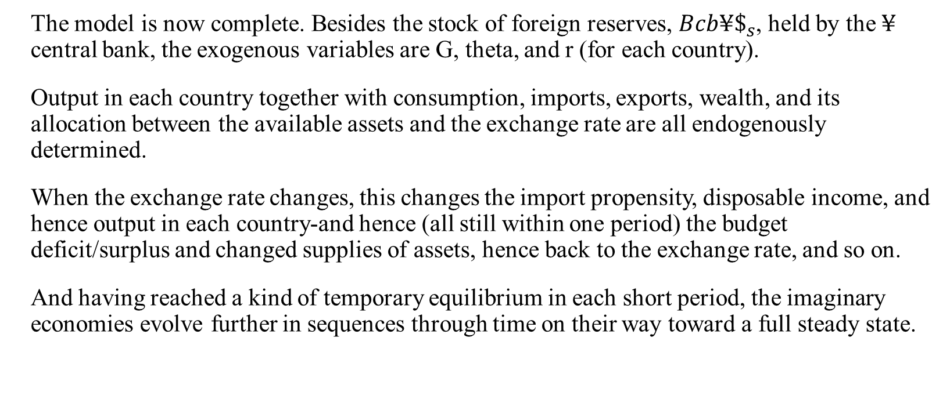
Behavior functions
The model is now complete. Besides the stock of foreign reserves, $Bcb¥\$_{s}$, held by the $¥$ central bank, the exogenous variables are G, theta, and r (for each country).
Output in each country together with consumption, imports, exports, wealth, and its allocation between the available assets and the exchange rate are all endogenously determined.
When the exchange rate changes, this changes the import propensity, disposable income, and hence output in each country-and hence (all still within one period) the budget deficit/surplus and changed supplies of assets, hence back to the exchange rate, and so on.
And having reached a kind of temporary equilibrium in each short period, the imaginary economies evolve further in sequences through time on their way toward a full steady state.

Slide 45
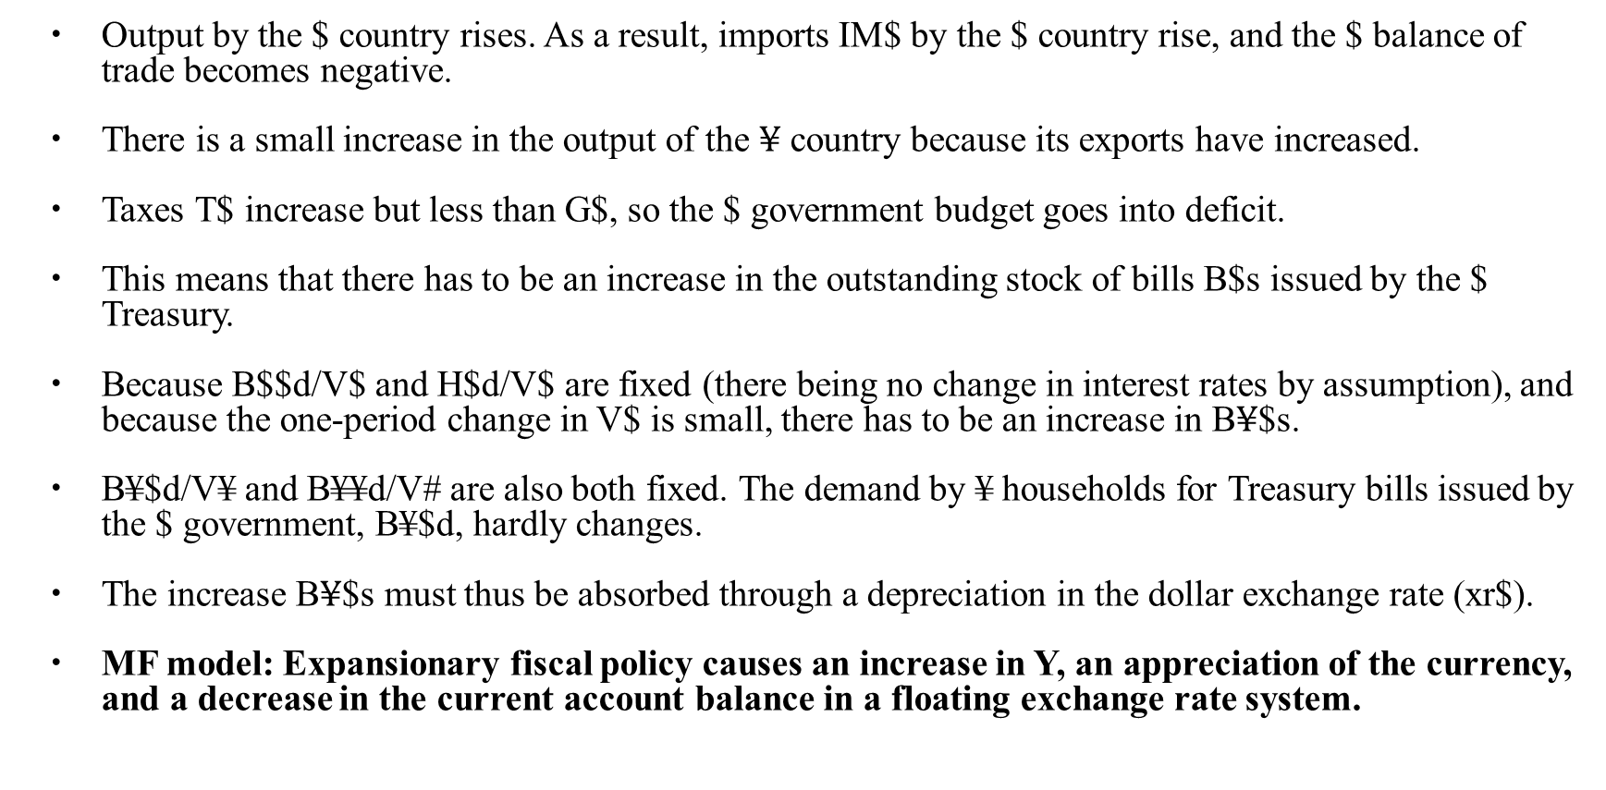
Simulation (1) Increasing government expenditure in one country (US)
Output by the $ country rises. As a result, imports IM$ by the $ country rise, and the $ balance of trade becomes negative.
There is a small increase in the output of the $¥$ country because its exports have increased.
Taxes T$ increase but less than G$, so the $ government budget goes into deficit.
This means that there has to be an increase in the outstanding stock of bills B$s issued by the $ Treasury.
Because B$$d/V$ and H$d/V$ are fixed (there being no change in interest rates by assumption), and because the one-period change in V$ is small, there has to be an increase in B$¥$$s.
B¥$d/V¥ and B¥¥d/V# are also both fixed. The demand by ¥ households for Treasury bills issued by the $ government, B¥$d, hardly changes.
The increase B$¥$$s must thus be absorbed through a depreciation in the dollar exchange rate (xr$).
MF model: Expansionary fiscal policy causes an increase in Y, an appreciation of the currency, and a decrease in the current account balance in a floating exchange rate system.

Slide 46
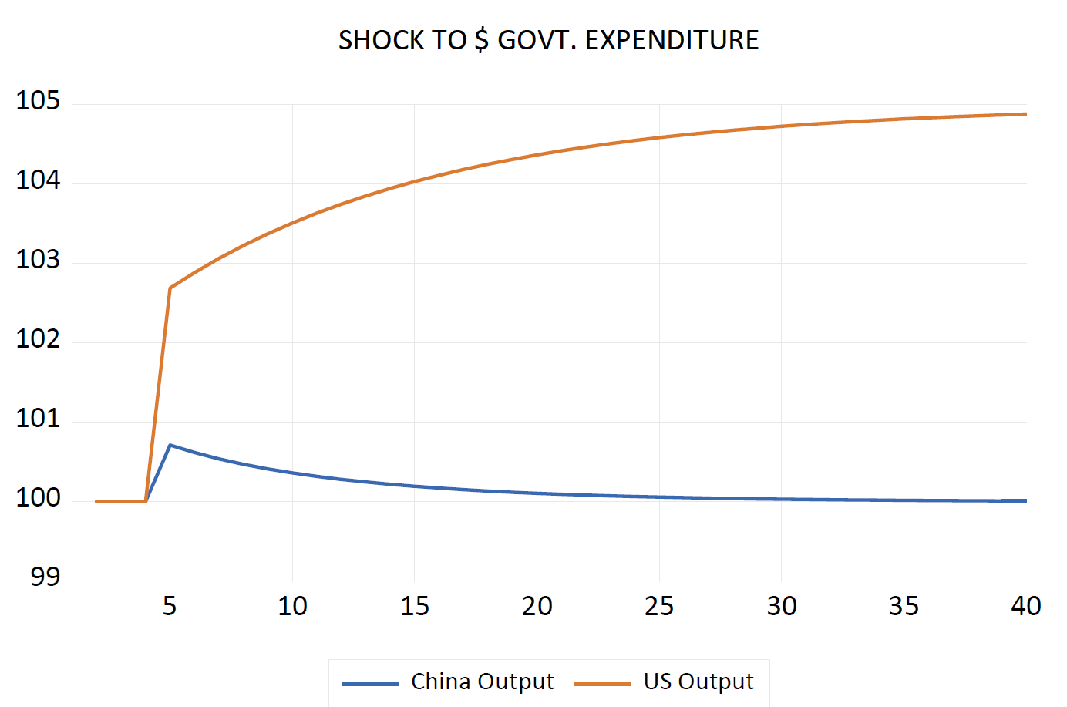
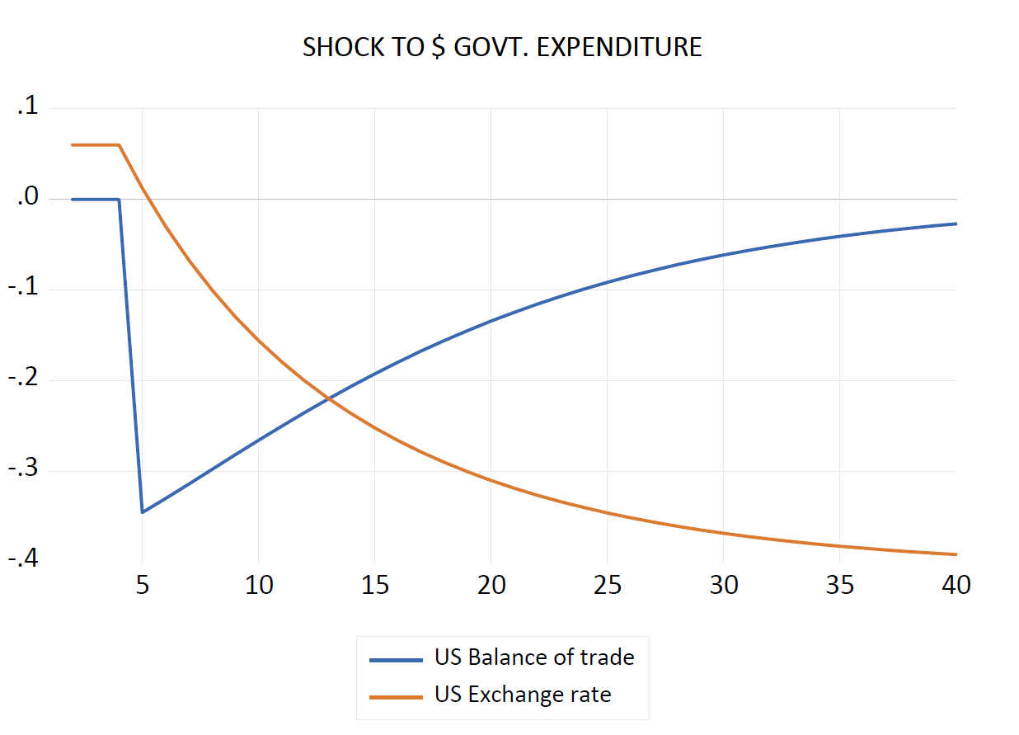
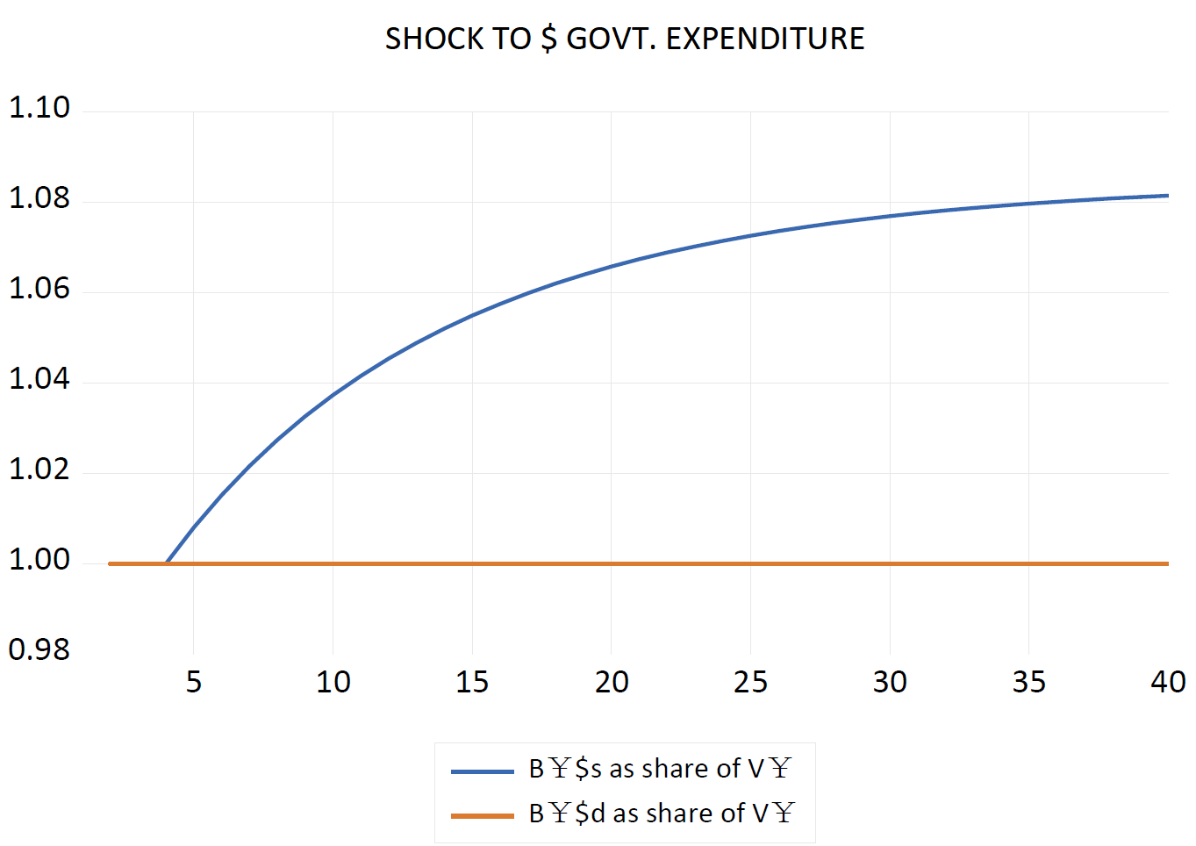
Simulation (1) Increasing government expenditure in one country (US)

Slide 47
Simulation (1) Increasing government expenditure in one country (US)
Next, the change in the exchange rate feeds into both import functions, reducing the import propensity in the $ country and raising it in the # country, thus eventually generating balanced trade in the $ country.
In addition, the falling dollar generates capital losses for residents in the # country where the value of the opening stock of bills issued abroad increases, and capital gains in the $ country, which confronts a reduced value of bills issued in the # country.
These revaluations of wealth stocks will feed into the asset demands in both countries in the same period, and affect consumption expenditures in the succeeding period, through a wealth effect.
Although the responses in the two countries are symmetrical, they will not, in general, be identical. The coefficients in the asset demand functions will, in general, be entirely different as between the two countries, yet there has to be only a single exchange rate to satisfy all the relevant responses.

Slide 48
Simulation (1) Increasing government expenditure in one country (US)
The one-period solution that this model generates when shocked does not simultaneously generate a new overall steady state in which the balance-of-payments imbalance is eliminated.
Rather, a new balance-of-payments deficit/surplus will occur, which will, in turn, generate a new, and similar, set of responses.
So long as the exogenous variables do not change, the exchange rate will go on falling at a reducing rate until a new full steady state is achieved.
Fiscal policy and also monetary policy in the form of interest rates are both under the full control of each government

Slide 49
Simulation (2) Exam Increasing interest rate in one country (US)
The rise in the $ rate of interest immediately leads to a brisk hike in the $ exchange rate, the value of the dollar in # units. In other words, there is a sudden appreciation of the dollar.
The higher $ rate of interest attracts net foreign capital, with all households now wanting to hold a larger proportion of $ Treasury bills and a smaller proportion of ¥ Treasury bills.
The share of $ bills in ¥ portfolios immediately rises and that of ¥ bills in ¥ portfolios falls by an equivalent amount so long as both shares are measured in ¥ currency.
However, this conceals the fact that, because the exchange rate has changed, the share of $ bills measured in $ currency initially falls, rising only at a later stage. The initial fall is due to the fact that, since there is an approximately constant supply of $ Treasury bills in the entire world, not all households will succeed in increasing their share of wealth held in the form of $ Treasury bills, when measured in dollars.
Households from the ¥ country will thus initially hold less $ Treasury bills, when measured in dollars, but they will succeed in holding more of them, when measured in their local currency. This will be achieved through an appreciated dollar.

Slide 50
Simulation (2) Exam Increasing interest rate in one country (US)
The stronger dollar will disturb the whole system by generating fiscal and trade imbalances. Because the stronger dollar will induce higher imports, the $ economy will run a trade account deficit. The latter, along with the capital losses of $ households on their holdings of foreign Treasury bills due to the depreciation of the # currency, will slow the $ economy and propel the $ government budget position into a deficit.
Because of this, $ Treasury bills will have to be newly issued. The outstanding stock of B$s will rise gradually, and thus respond to the higher demand for this security. As a result, the value of the dollar will revert toward its original value, and so will the output of the $ country.
US: The stronger dollar will induce higher imports, the $ economy will run a trade account deficit. Trade deficit + capital losses of $ households→ $ government deficit→ The outstanding stock of B$s will rise →xr$ and the output of the $ country will revert to original values.

Slide 51
Simulation (2) Exam Increasing interest rate in one country (US)
A symmetric process will occur in the # country. The appreciation of the dollar will lead to an increase in exports and capital gains for households holding dollar-denominated securities. Both of these effects will induce an initial boost in the output of the # country, as well as a trade surplus and a budget surplus. There will thus be a reduction in the outstanding stock of # Treasury bills, B#s, which will correspond to the reduced demand for this security caused by the higher $ interest rate. This will contribute to bringing back the value of the dollar to its original value.
Thus, in this model, an increase in the interest rate leads to a slow down of the $ economy through the exchange rate channel, but this negative impact is only temporary. In the new steady state, both economies are back to their initial flow levels, except that the $ country, which imposed the higher interest rate, is now stuck with more substantial public debt and foreign debt.
China: The stronger dollar will induce higher exports, the ¥ economy will run a trade account surplus. Trade surplus + capital gains of ¥ households→ ¥ government surplus→ The outstanding stock of B¥s will fall →xr$ and the output of the ¥ country will revert to original values.

Slide 52
Simulation (2) Exam Increasing interest rate in one country (US)
Changes in liquidity preference or speculative activity could be represented within the framework outlined above.
An increase in the liquidity preference of asset holders in favor of $ Treasury bills would lead to the same dynamics.
This is because such a change in liquidity preference, just as an increase in the $ interest rate, leads to an attempt by households to increase the share of $ securities in their portfolios. Thus, such a change in liquidity preference would impose fluctuations in the exchange rate, and it would induce transitory changes in output and consumption.
In the current case, it would lead to a monetary slow down of the $ economy, through the exchange rate channel. The system, by inducing a $ government deficit, would create the $ government assets that the investors desire.

Slide 53
Simulation (2) Exam Increasing interest rate in one country (US)
To sum up, we see that monetary policy, defined as administered interest rate, is relatively less effective than fiscal policy, because its effect on output is only temporary, where fiscal policy has a permanent effect.
This is in contrast with M-F model, where fiscal policy is less effective in flexible exchange rate.
In addition, higher G here leads to a depreciation of $, because of the induced trade deficit.
By contrast, the M-F model concludes that higher G leads to an appreciation of domestic currency (provided the BP curve is flat, when securities are perfect substitutes, or at least fatter than the LM curve), arising from a capital account surplus. This surplus is generated by higher interest rate, caused by crowding out, which results from unrealistic assumption that CB holds constant money supply despite an increased demand for money.

Slide 54
Simulation (2) Exam Increasing interest rate in one country (US)
The result that we achieved with fiscal policy could be derived from the standard IS-LM-BP graph of a modified Mundell-Fleming model.
Assume that the LM curve is flat, while the other two curves have their usual shapes.
An increase in government expenditures shifts the IS curve to the right, thus leading to a new internal equilibrium that is situated below the BP curve, inducing a depreciation of the domestic currency and hence inducing further rightward shifts of the IS and BP curves.
By contrast, the IS-LM-BP graph would not be able to show that the positive effects of an interest rate reduction would mainly be temporary.

Slide 55
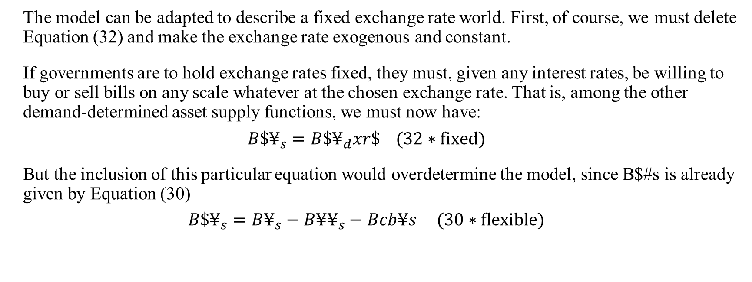
A fixed exchange regime closure
The model can be adapted to describe a fixed exchange rate world. First, of course, we must delete Equation (32) and make the exchange rate exogenous and constant.
If governments are to hold exchange rates fixed, they must, given any interest rates, be willing to buy or sell bills on any scale whatever at the chosen exchange rate. That is, among the other demand-determined asset supply functions, we must now have:
$$B\$¥_{s}=B\$¥_{d}xr\$ (32∗fixed)$$
But the inclusion of this particular equation would overdetermine the model, since B$#s is already given by Equation (30)
$$B\$¥_{s}=B¥_{s}−B¥¥_{s}−Bcb¥s (30∗flexible)$$

Slide 56
A fixed exchange regime closure
There are three obvious possibilities if we imagine this system out of balance.
1. fiscal policy of the deficit country must adjust to neutralize an ex ante excess supply of bills flowing into the market (in which case it must be endogenized);
2. The (endogenous) interest rate in the deficit country must rise indefinitely so that (in theory) a continuing increase in the relative supply of bills by the deficit country is always willingly held.
3. The remaining possibility is that the central bank of the surplus country acquires (while the deficit country disposes of) reserve assets on a limitless scale, as was discussed in the first section of this paper in the case of the single economy.
We proceed to explore the last of these three possibilities, noting in advance that, under this assumption, both governments still retain full control over both fiscal and monetary policy.

Slide 57
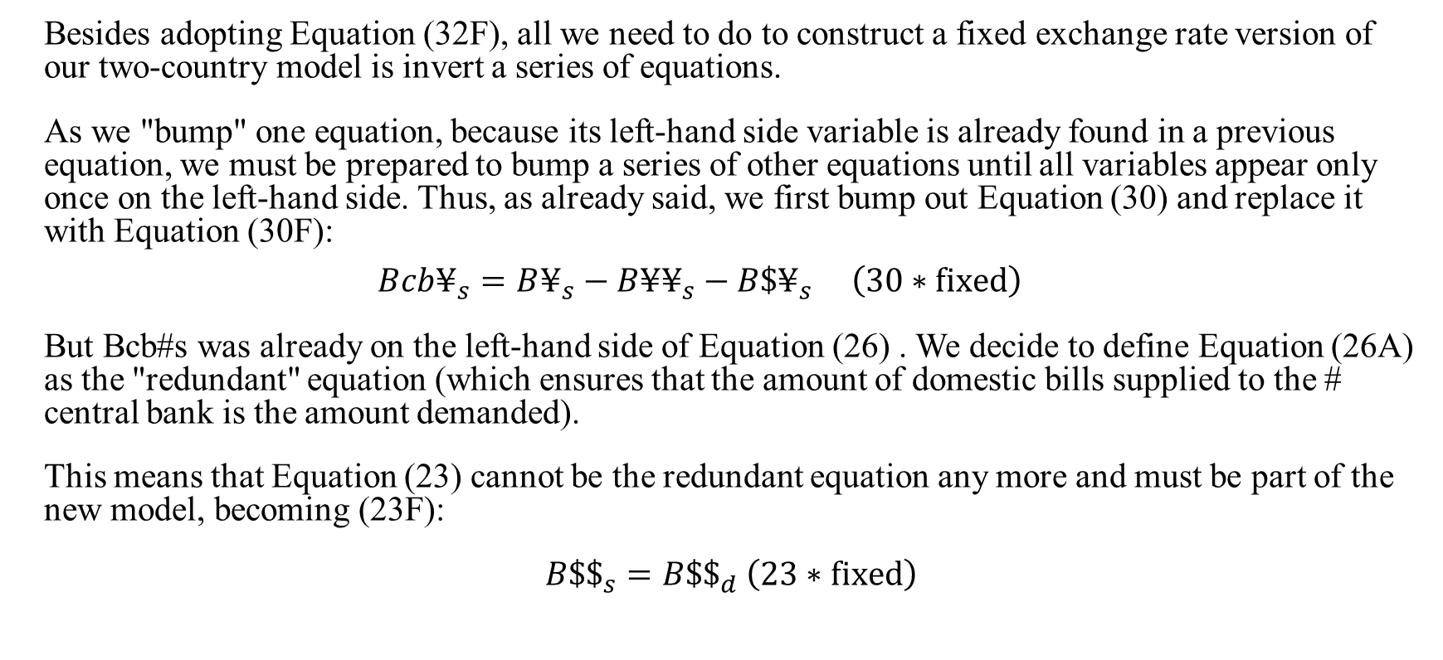
A fixed exchange regime closure
Besides adopting Equation (32F), all we need to do to construct a fixed exchange rate version of our two-country model is invert a series of equations.
As we "bump" one equation, because its left-hand side variable is already found in a previous equation, we must be prepared to bump a series of other equations until all variables appear only once on the left-hand side. Thus, as already said, we first bump out Equation (30) and replace it with Equation (30F):
$$Bcb¥_{s}=B¥_{s}−B¥¥_{s}−B\$¥_{s} \left(30∗fixed\right)$$
But Bcb#s was already on the left-hand side of Equation (26) . We decide to define Equation (26A) as the "redundant" equation (which ensures that the amount of domestic bills supplied to the # central bank is the amount demanded).
This means that Equation (23) cannot be the redundant equation any more and must be part of the new model, becoming (23F):
$B\$\$_{s}=B\$\$_{d}$ $\left(23∗fixed\right)$

Slide 58
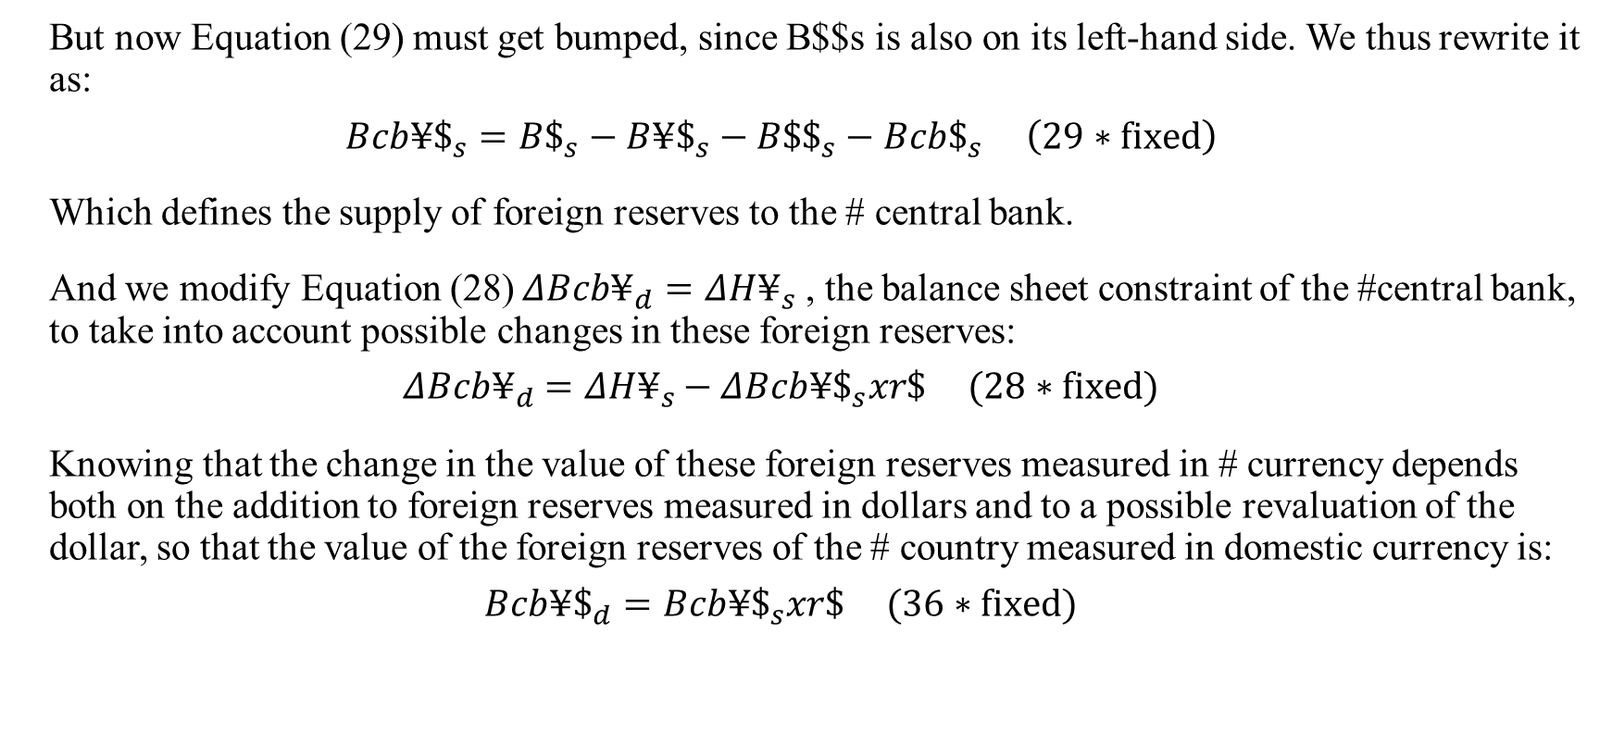
A fixed exchange regime closure
But now Equation (29) must get bumped, since B$$s is also on its left-hand side. We thus rewrite it as:
$$Bcb¥\$_{s}=B\$_{s}−B¥\$_{s}−B\$\$_{s}−Bcb\$_{s} \left(29∗fixed\right)$$
Which defines the supply of foreign reserves to the # central bank.
And we modify Equation (28) $ΔBcb¥_{d}=ΔH¥_{s}$, the balance sheet constraint of the #central bank, to take into account possible changes in these foreign reserves:
$$ΔBcb¥_{d}=ΔH¥_{s}−ΔBcb¥\$_{s}xr\$ (28∗fixed)$$
Knowing that the change in the value of these foreign reserves measured in # currency depends both on the addition to foreign reserves measured in dollars and to a possible revaluation of the dollar, so that the value of the foreign reserves of the # country measured in domestic currency is:
$$Bcb¥\$_{d}=Bcb¥\$_{s}xr\$ (36∗fixed)$$

Slide 59
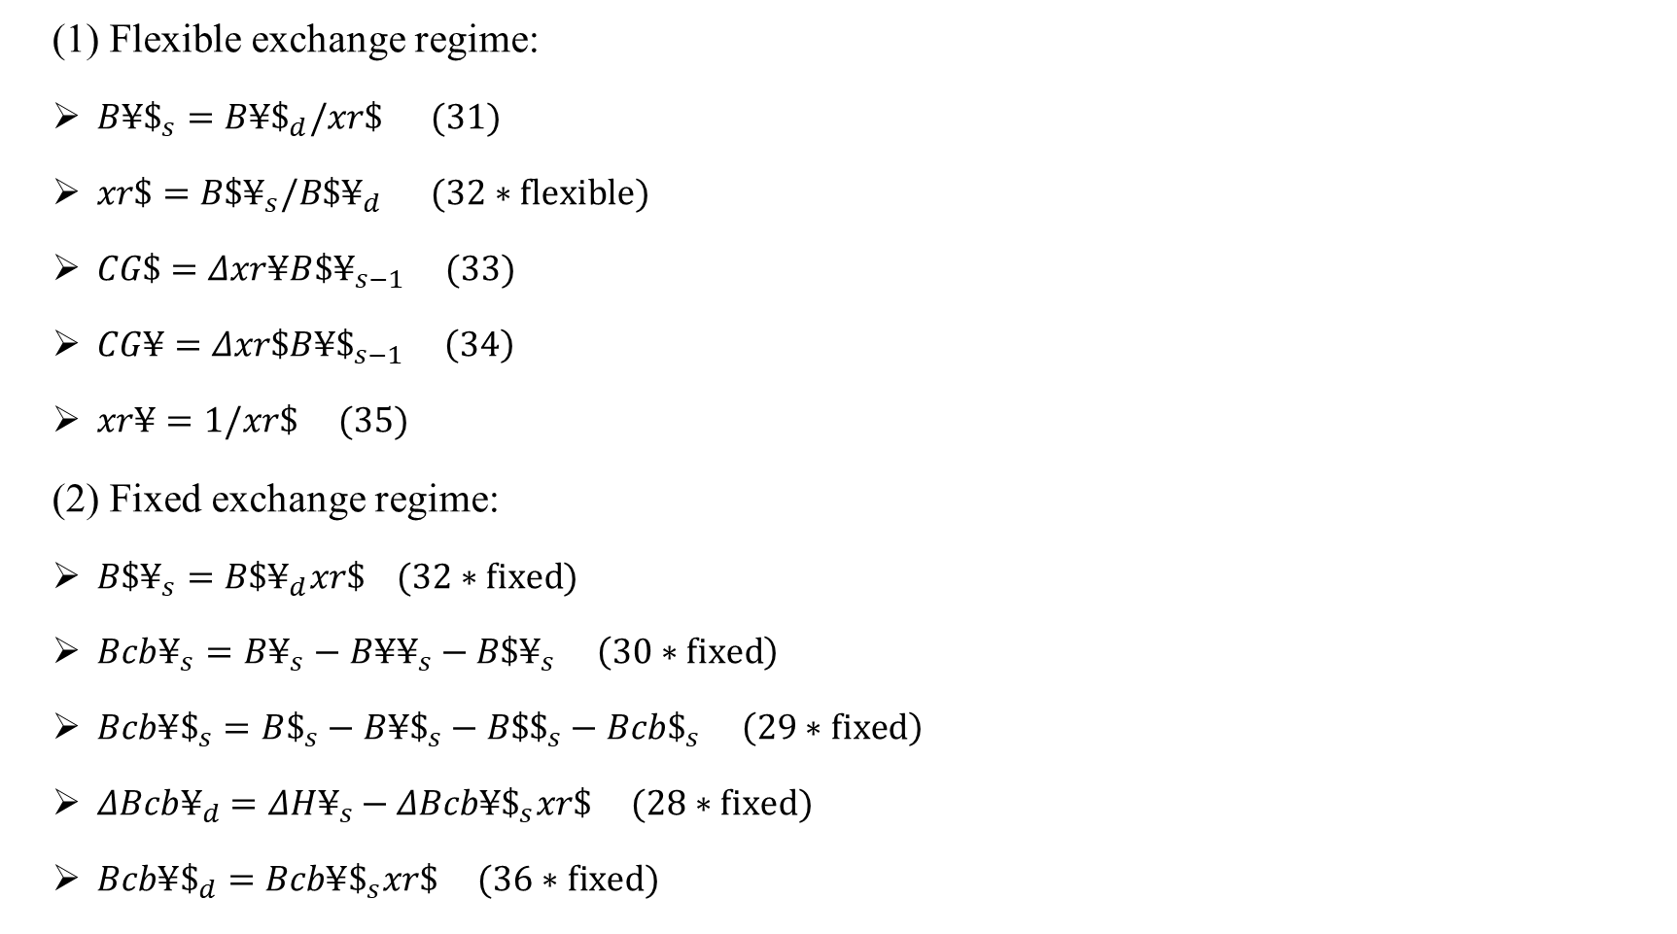
Model closure (flexible VS fixed exchange regime)
(1) Flexible exchange regime:
$B¥\$_{s}=B¥\$_{d}/xr\$ (31)$
$xr\$=B\$¥_{s}/B\$¥_{d} (32∗flexible)$
$CG\$=Δxr¥B{\$¥}_{s−1} (33)$
$CG¥=Δxr\$B¥\$_{s−1} \left(34\right)$
$xr¥=1/xr\$ (35)$
(2) Fixed exchange regime:
$B\$¥_{s}=B\$¥_{d}xr\$ (32∗fixed)$
$Bcb¥_{s}=B¥_{s}−B¥¥_{s}−B\$¥_{s} \left(30∗fixed\right)$
$Bcb¥\$_{s}=B\$_{s}−B¥\$_{s}−B\$\$_{s}−Bcb\$_{s} \left(29∗fixed\right)$
$ΔBcb¥_{d}=ΔH¥_{s}−ΔBcb¥\$_{s}xr\$ (28∗fixed)$
$Bcb¥\$_{d}=Bcb¥\$_{s}xr\$ (36∗fixed)$

Slide 60
A fixed exchange regime closure
The two-country fixed exchange regime model is now complete.
The case we want to illustrate is where a surplus country (China) wishes to maintain its surplus and, in so doing, purchases reserve assets (U.S. Treasury bills) on whatever scale is necessary to keep the exchange rate where it is.
The model says that there is no limit to this process.
We start from a full stationary state (with no external imbalance) and assume that the $ propensity to import rises permanently.
The Chinese economy reaches a new quasi stationary state with a constant surplus in the trade account (and in the overall balance of payments).
All flows and all privately held stocks, including the stock of money, do not change at all.

Slide 61
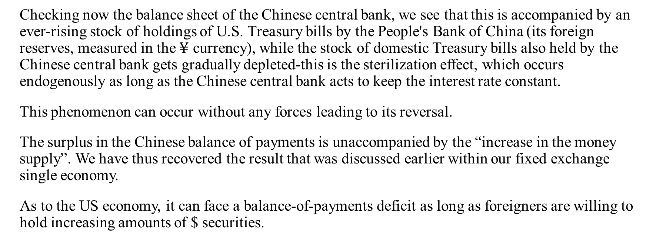
A fixed exchange regime closure
Checking now the balance sheet of the Chinese central bank, we see that this is accompanied by an ever-rising stock of holdings of U.S. Treasury bills by the People's Bank of China (its foreign reserves, measured in the $¥$ currency), while the stock of domestic Treasury bills also held by the Chinese central bank gets gradually depleted-this is the sterilization effect, which occurs endogenously as long as the Chinese central bank acts to keep the interest rate constant.
This phenomenon can occur without any forces leading to its reversal.
The surplus in the Chinese balance of payments is unaccompanied by the “increase in the money supply”. We have thus recovered the result that was discussed earlier within our fixed exchange single economy.
As to the US economy, it can face a balance-of-payments deficit as long as foreigners are willing to hold increasing amounts of $ securities.

Slide 62
A fixed exchange regime closure
In the fixed exchange rate regime, fiscal expansion leads to a permanently increased output but is accompanied by a twin deficit.
It would seem that fiscal and monetary policies are relatively more effective in the context of flexible exchange rate regimes.
Indeed, lower interest rates, unsurprisingly have only one effect-a temporary capital account deficit. If we further assume that consumption depends negatively on interest rates, a reduction in interest rates leads to a sharp capital account deficit that quickly turns into a temporary surplus, a temporary increase in consumption and income, and a temporary budget surplus and trade deficit. This is shown in Figure 8, and it clearly illustrates the fact that the twin deficit proposition holds in the steady state, but not necessarily during the transition, when households accumulate or get rid of financial assets.

Slide 63
Simulation (Fixed Exchange Rate Model) Shock: an increase in the US propensity to import
1) freeze(chart1) chart1_g.line
chart1.elem(1) legend(China Output)
chart1.elem(2) legend(US Output)
2) freeze(chart2) chart2_g.line
chart2.elem(1) legend(US Balance of trade)
chart2.elem(2) legend(China Balance of trade)
chart2.elem(3) legend(Exchange rate)
3) freeze(chart3) chart3_g.line
chart3.elem(1) legend(Stock of money in China)
chart3.elem(2) legend(Foreign reserves of China central bank)
chart3.elem(3) legend(Stock of China bills held by China central bank)

Slide 64
Shock: an increase in the US propensity to import

Slide 65
Mundell-Fleming Framework
One of the most misinterpreted concepts in open macroeconomics is the implication of a country’s trade deficit or surplus.
Often it is incorrectly presumed that a trade deficit is bad while a trade surplus is a sign of strong economics.
Trade deficits are often incorrectly presumed to cause unemployment.
The job-loss story is incomplete though because it ignores the demand and jobs caused by the financial account surplus.
When trade deficits arise on the current account, there is an equal and opposite trade surplus on the financial account of the balance of payments. A financial account surplus means that foreigners are purchasing domestic assets, such as government bond, stocks and real estate. In any case, that money flows back into the deficit country and ultimately is spent by someone. When it is spent, it creates demands for goods and services that in turn create jobs.

Slide 66
Mundell-Fleming Framework
Trade surpluses can be viewed as a sign of weakness for China’s economy.
A trade surplus implies the country has a financial account deficit. Thus, Chinese citizen are lending (such as making loans to the rest of the word) rather than consuming some of the money available from production.
This means that a trade surplus reduces a country’s potential for consumption and investment below what is achievable in balanced trade.
In this sense, the short-run effect of trade surpluses is reducing living standards.
However, in the long run, when China redeems its past loans with interest, it can run a trade deficit, and domestic spending will exceed GDP.

Slide 67
Mundell-Fleming Framework
In the Mundell-Fleming framework, the fixed and float regimes produce diametrically opposed results concerning the effectiveness of fiscal and monetary policies. Under a floating rate, fiscal policy was ineffective and monetary policy was very effective. Under a fixed rate, monetary policy is ineffective and fiscal policy is very effective.
When the exchange rate is fixed, money supply must be used to keep the exchange rate stable, so the government cannot determine money supply freely. In other words, a fixed exchange rate ties the hands of the monetary authority.
Foreign exchange market intervention: the central bank purchases foreign assets (typically US dollar assets including dollar deposits, US government securities, etc). International reserves (IR) increases and the payment for it also increases base money (H). The reverse happens when the central bank sells foreign assets.
Under a fixed exchange rate system, the central bank has the obligation to keep the exchange rate fixed by passive foreign exchange intervention. This means that it must continue to sell or buy IR so that the nominal exchange can remain stable. Therefore, IR is uncontrollable.

Slide 68
Mundell-Fleming Framework
Sterilization: even with a fixed exchange rate, can the central bank still control money supply through open market operation (changes in domestic credit, DC) to offset the effect of passive foreign exchange intervention (changes in IR)? Even though IR is uncontrollable, we can still use DC to keep H (=IR+DC) constant at some desirable level.
This idea of offsetting the change in IR by manipulating DC is called “sterilization”.
Whether this is possible depends on the degree of capital mobility: If capital movement is controlled, sterilization may be possible for a considerable time. But if capital is perfectly mobile. In particular, money supply is determined by money demand. Any attempt to increase DC will be immediately offset by a loss of IR of the same amount. The central bank cannot change money supply at all; it can only change its composition (relative shares of IR and DC). In this case, sterilization is not possible.
Money is endogenous under a fixed exchange rate, and any attempt for sterilization is futile when capital is perfectly mobile.

Slide 69
Mundell-Fleming Framework
With a floating exchange rate, the monetary authority does not intervene in the foreign exchange market. This means that there is no change in international reserves.
Under a floating exchange rate and perfect capital mobility, fiscal policy is ineffective: An increase in G puts an upward pressure on the domestic interest rate; But this immediately invites a massive capital inflow; This appreciates the exchange rate; This worsens the trade balance. The exchange rate appreciates and the trade balance worsens until the initial increase in G is completely offset. Y cannot increase at all.
The Mundell-Fleming model shows that the effectiveness of national macroeconomic policy depends on the exchange rate system. This is because in open economy the real exchange rate influence net export and thus income.
It is important to remember that maintenance of fixed exchange rate is possible only in case of having sufficient official reserves. Hence, if a country faces balance of payments deficit in a long term then the central bank will have to eventually devaluate national currency.

Slide 70
Mundell-Fleming Model with a Floating Exchange Rate
The Mundell-Fleming model is an open macro application of the standard IS-LM analysis. More precisely, it is an IS-LM analysis with trade and international capital mobility.
Theoretically, it is the most popular model. But its applicability to actual policy making is not as high as we would hope (especially for developing and transition countries).
Consider the following three aspects of the macroeconomy:
(1) Aggregate demand (IS and LM curves, representing goods and money markets)
(2) Aggregate supply (production function and labor market)
(3) Balance of payments (current account and capital account)
The usual textbook exposition (with no trade or capital mobility) combines (1) and (2), with a downward sloping AD (aggregate demand) curve and an upward-sloping AS (aggregate supply) curve.

Slide 71
Mundell-Fleming Model with a Floating Exchange Rate
The Mundell-Fleming model combines (1) and (3), namely AD and B (balance of payments) curves.
This means that the Mundell-Fleming model (in its simplest version) has no supply side constraint. As in the most elementary Keynesian model, it implicitly assumes that capital and labor are generally underemployed so that any demand stimulus will expand real GDP (rather than cause inflation).
IS curve:
Y =C + I + G + T = A (Y, i; G) + T (q, Y*, Y) = F (Y, i, q; G)
Y: income C: private consumption I: private investment G: government spending, i: interest rate
T1 >0, namely, partial derivative of trade balance with respect to q is positive. This means that the Marshall-Lerner condition is satisfied, so real depreciation will improve the trade balance (when other variables remain unchanged).
q = EP*/P

Slide 72
Mundell-Fleming Model with a Floating Exchange Rate
IS curve:
Y =C + I + G + T = A (Y, i; G) + T (q, Y*, Y) = F (Y, i, q; G)
Y = f (i, q; G) f1 <0, f2 >0, f3 >0
It is downward-sloping in the (i, Y) plane. Moreover, a rise in q (real depreciation) or a rise in G (government spending) shifts the IS curve up and to the right.
LM curve:
Ms/P = LD (i, Y) LD1 <0, LD2 >0
As in the domestic version, it is upward-sloping in the (i, Y) plane. A rise in money supply Ms shifts the LM curve down and to the right. In this formulation, the price level P is assumed fixed.
This may be unrealistic in a small open economy where exchange rate pass-through (E -> P) is significant.

Slide 73
Mundell-Fleming Model with a Floating Exchange Rate
Balance of payments:
The balance of payments (B) is the sum of current account (T) and capital account (K). For simplicity we have assumed away the flows of service, factor income and transfers so that the current account is identical with the trade balance.
B = T + K=T (q, Y) + K (i - i*)=0 T1 >0, T2 <0; K1 > 0
The exchange rate is floating
The monetary authority does not intervene in the foreign exchange market. This means that there is no change in international reserves, and therefore the current account and the capital account must always add up to zero (T + K = 0).
Perfect capital mobility. This means that i = i*, K1 = +∞, and K is indeterminate. In other words, if i > i* there will be a massive capital inflow into the home country and if i < i* there will be a massive outflow, so the only way K can remain finite is when i = i*. When that happens, K can take any value (positive or negative) to offset T, so that T + K = 0 holds.

Slide 74
Mundell-Fleming Model with a Floating Exchange Rate
Balance of payments:
The exchange rate expectation is static. That is to say, people expect that the future exchange rate will be the same as today's (even though the exchange rate is floating). This is a simplifying assumption. Thus, instead of the usual uncovered interest parity (i = i* + x), we have i = i* (because x = 0).
If we depict this situation in the (i, Y) plane, we have a horizontal line at i*. The domestic interest rate must be equal to the world interest rate. There will be a massive capital inflow above that line, and a massive capital outflow below that line.
Under a freely floating exchange rate and perfect capital mobility, the equilibrium:
Y = f (i, q; G) f1 <0, f2 >0, f3 >0 <IS>
Ms/P = LD (i, Y) LD1 <0, LD2 >0 <LM>
i = i* <BOP>

Slide 75
Mundell-Fleming Model with a Floating Exchange Rate
Comparative statics: it is a matrix of signs (+ or -) indicating the changes in endogenous variables in response to a change in each exogenous variable.
Fiscal expansion:
1. An increase in G shifts the IS curve upward and to the right. 2. This puts an upward pressure on the domestic interest rate (i > i*). 3. But this immediately invites a massive capital inflow. 4. This appreciates the nominal exchange rate E as well as the real exchange rate q. 5. This worsens the trade balance T.
As the model is constructed, no gradual adjustment is allowed; these events are supposed to take place instantaneously. The exchange rate appreciates and the trade balance worsens until the initial increase in G is completely offset.
The IS curve is pushed back to the original position, and Y cannot increase at all.

Slide 76
Mundell-Fleming Model with a Floating Exchange Rate
Fiscal expansion:
What happened is that, in Y = A + T, as A is increased by fiscal spending, T is reduced by exactly the same amount. Y is unchanged, and only the relative composition of Y is changed.
The conclusion is that under a floating exchange rate and perfect capital mobility, fiscal policy is ineffective.
Monetary expansion:
1. An increase in Ms shifts the LM curve downward and to the right. 2. This puts a downward pressure on the domestic interest rate (i < i*). 3. But this immediately invites a massive capital outflow. 4. This depreciates the nominal exchange rate E as well as the real exchange rate q. 5. This improves the trade balance T.

Slide 77
Mundell-Fleming Model with a Floating Exchange Rate
Monetary expansion:
Again, the whole sequence is assumed to take place in an instant. Compared with the domestic version of IS-LM, monetary policy is more powerful because the outward shift of LM invites an additional outward shift of IS. Both LM and IS cooperate to increase income.
The conclusion is that under a floating exchange rate and perfect capital mobility, monetary policy is very effective.
These conclusions are significantly different from those of the domestic version of the IS-LM model.
In the domestic version, fiscal and monetary policies are both effective, and their relative effectiveness depends on various elasticities and slopes. But in this case, one policy is utterly impotent and the other policy is doubly potent.

Slide 78
Mundell-Fleming Model with a Fixed Exchange Rate
In the Mundell-Fleming framework, the two versions (fixed and float) produce diametrically opposed results concerning the effectiveness of fiscal and monetary policies. As we recall, under a floating rate, fiscal policy was ineffective and monetary policy was very effective. Under a fixed rate, monetary policy is ineffective and fiscal policy is very effective.
Under a fixed exchange rate, money supply is endogenous. The term endogenous means that its magnitude is determined as a result of the working of the entire model and, therefore, cannot be pre-determined by outside forces (including by the policy authority).
High-powered money is also called base money or monetary base.
In the balance sheet of the central bank, H is the central bank’s liabilities. It is also equal to its assets, which are the sum of international reserves (IR) and domestic credit (DC).
DC includes government bonds and bills, loans to the public sector, and loans to commercial banks.

Slide 79
Mundell-Fleming Model with a Fixed Exchange Rate
There are two ways for the central bank to increase or decrease H:
(1) Open market operation: the central bank purchases domestic assets (typically government bonds). DC increases and the payment for it (in cash or in credit to bank deposits) increases H by the same amount. The reverse happens when the central bank sells domestic assets.
(2) Foreign exchange market intervention: the central bank purchases foreign assets (typically US dollar assets including dollar deposits, US government securities, etc). IR increases and the payment for it also increases H. The reverse happens when the central bank sells foreign assets.
However, under a fixed exchange rate system, the central bank has the obligation to keep the exchange rate fixed by passive foreign exchange intervention. This means that it must continue to sell or buy IR so that the nominal exchange can remain stable.
Therefore, IR is uncontrollable while DC is controllable (at least for the moment) under a fixed rate regime.

Slide 80
Mundell-Fleming Model with a Fixed Exchange Rate
B = T (q, Y) + K (i - i*) - [increase in IR] = 0 T1 >0, T2 <0; K1 > 0
We have added -[increase in IR] to represent the central bank intervention. This is because the central bank must now ensure that there is no pressure in the foreign exchange market to either appreciate or depreciate the home currency (B=0). If the overall balance is in surplus (T+K>0), the central bank must buy dollars and sell domestic currency. This increases IR, H and ultimately M. If the overall balance is in deficit, it must do the opposite. The overall balance must always be offset by such an operation.
Degree of capital mobility:
If capital is not mobile internationally, then K=0, always. The balance of payments is now the same as the trade balance, plus intervention. The balance of payments equilibrium (B=0 without intervention) is achieved only when T=0. But there is only one Y (GDP) that makes that happen, because q (real exchange rate) cannot be changed. The balance of payments line becomes vertical in the (i, Y) plane.

Slide 81
Mundell-Fleming Model with a Fixed Exchange Rate
To the right of this line, the trade balance is in deficit (T<0) so the central bank must sell dollars, and IR and M are decreasing. To the left of this line, we have T>0, and IR and M are increasing.
If, by contrast, there is perfect capital mobility, we must have i = i*. If not, there is a massive capital inflow or outflow so B=0 cannot be maintained. Thus, the balance of payments line is horizontal at i = i*. Above it, we have a big capital inflow; below it, a big capital outflow.
Sterilization：
Let us ask the question: even with a fixed exchange rate, can the central bank still control money supply through open market operation (changes in DC) to offset the effect of passive foreign exchange intervention (changes in IR)?
Even though IR is uncontrollable, we can still use DC to keep H (=IR+DC) constant at some desirable level. Then we can insulate money supply from external effects and regain monetary independence. For example, even if T+K<0, money supply need not shrink. More generally, the central bank can set H and M independently, regardless of the balance of payments situation.

Slide 82
Mundell-Fleming Model with a Fixed Exchange Rate
This idea of offsetting the change in IR by manipulating DC is called “sterilization”. It means sterilizing (=killing, cutting off) the effect of foreign exchange intervention on domestic money supply.
Again, whether this is possible depends on the degree of capital mobility.
If capital movement is controlled, sterilization may be possible for a considerable time. Suppose the economy is to the right of the T=0 line above, and the central bank is losing IR. But it can sustain the situation by increasing DC, until finally IR is depleted (when IR reaches zero, that is the end of the game). You can also remain to the left of T=0 and gain IR.
But if capital is perfectly mobile, i (=i*), Y and Ms are all given by IS, LM and BOP conditions. In particular, money supply Ms is determined by money demand LD. Any attempt to increase DC will be immediately offset by a loss of IR of the same amount. The central bank cannot change money supply at all; it can only change its composition (relative shares of IR and DC). In this case, sterilization is not possible.

Slide 83
Mundell-Fleming Model with a Fixed Exchange Rate
Equilibrium with no capital mobility
Y = f (i, q; G) f1 <0, f2 >0, f3 >0 <IS>
Ms/P = LD (i, Y) LD1 <0, LD2 >0 <LM>
T (q, Y) = 0 T1 >0, T2 <0 <BOP>
Equilibrium under perfect capital mobility
Y = f (i, q; G) f1 <0, f2 >0, f3 >0 <IS>
Ms/P = LD (i, Y) LD1 <0, LD2 >0 <LM>
i = i* <BOP>

Slide 84
Mundell-Fleming Model with a Fixed Exchange Rate
Equilibrium with no capital mobility:
Since the real exchange rate q is given and unchanged by assumption, we can ignore it for now.
Output Y and the interest rate i are determined by IS and LM as if in a purely domestic macro model. IS is downward sloping and LM is upward sloping in the (i, Y) plane. The economy goes to the intersection of IS and LM. This is the short-run equilibrium.
But this is not the final outcome. This short-run equilibrium may be off the BOP line (T=0).
If it is to the right of T=0, there is a trade deficit because Y is too large. To keep the exchange rate fixed, the central bank is obliged to sell dollars, lose IR and reduce H. Gradually, money supply Ms falls and the LM curve shifts up and to the left—until the three lines (IS, LM, T=0) intersect at the same point. After that, there is no more movement; we have reached the long-run equilibrium.
The government can resist the shift of LM by sterilization. But eventually, it will run out of international reserves. Then the process above must continue.

Slide 85
Mundell-Fleming Model with a Fixed Exchange Rate
Equilibrium under perfect capital mobility:
Money is endogenous under a fixed exchange rate, and any attempt for sterilization is futile when capital is perfectly mobile. So we know monetary policy can do nothing.
To be more precise, consider an attempt at monetary expansion by increasing DC (open market purchase of domestic government bonds). The LM curve wants to shift down and to the right, but this movement is immediately countered by a massive capital outflow and a loss of IR, at the slightest fall of the domestic interest rate. So the total high powered money H (=DC+IR) remains constant. LM cannot shift.
The conclusion is that under a fixed exchange rate and perfect capital mobility, monetary policy is ineffective.
With a floating exchange rate, a massive capital outflow prompted currency depreciation and an export boom. Here, with a fixed exchange rate, it simply leads to the loss of international reserves.

Slide 86
Mundell-Fleming Model with a Fixed Exchange Rate
Fiscal policy:
If government spending G is increased, the IS curve is pushed up and to the right. But this tends to raise i and generate a massive capital inflow. To prevent an appreciation of the domestic currency, the central bank must buy up dollars, which will increase IR and H. Money supply Ms jumps up and the LM curve shifts out as a consequence.
Note that this occurs instantaneously. Unlike the case of no capital mobility, there is no distinction between shortrun and long-run. Everything takes place at once.
Since both IS and LM shifts to the right, Y is doubly increased.
The conclusion is that under a fixed exchange rate and perfect capital mobility, fiscal policy is very effective.

Slide 87
开放经济下的存量—流量一致模型
货币的创造有两种根本不同的方式。一方面，有外部货币，这是在政府通过在中央银行透支或者进行政府购买时产生的，当私人部门以税收的形式向政府付款时，外部货币就灭失了。它是由公共机构（即中央银行或中央政府的财政部门）发行的，在文献中，通常被称为高能货币。
另一方面，有内部货币，它是商业银行发放贷款时创造的，当贷款被偿还时，它就不复存在了，第二种货币称为私人货币，因为它是由即私人银行（商业银行）发行的。
我们假设存在一种服务经济，在这种经济中，除了政府机构之外，经济主体在概念上可以分为两种：一种是作为企业而出售服务和支付工资，另一种是作为家庭而获得收入、消费和积累资产。
所有的生产都是由服务提供者承担的，他们没有固定设备，也没有中间成本。假定服务的生产是瞬时的，因此不存在库存。因此，对存货积累进行融资就没有必要了。
没有私人银行，也没有任何利润。我们处在一个纯劳动经济中。

Slide 88
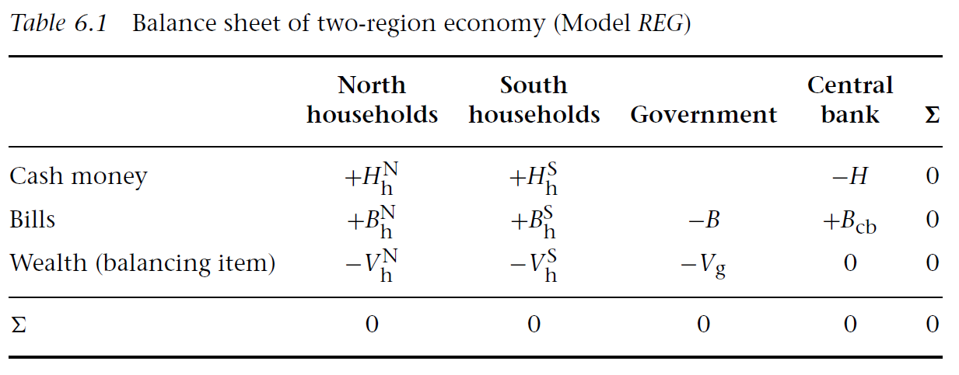
两地区存量—流量一致模型
将封闭的经济分为“北方”和“南方”两部分，但保留单一政府、单一财政和货币体系以及单一货币。
表6.1显示了两地区经济模型的资产负债表。家庭被细分为两组，即生活在北方的家庭和生活在南方的家庭。Vg代表联邦政府的净财富，它呈现负值，因为政府没有资产，只有负债，用B表示。因此，Vg描述了两个地区的家庭所获得总的净财富。

Slide 89
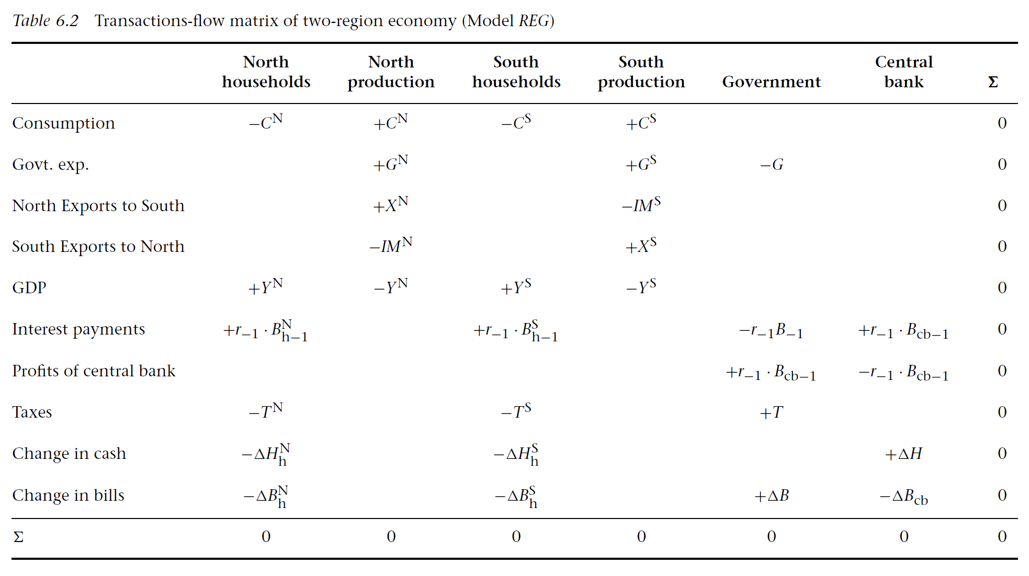
两地区存量—流量一致模型

Slide 90
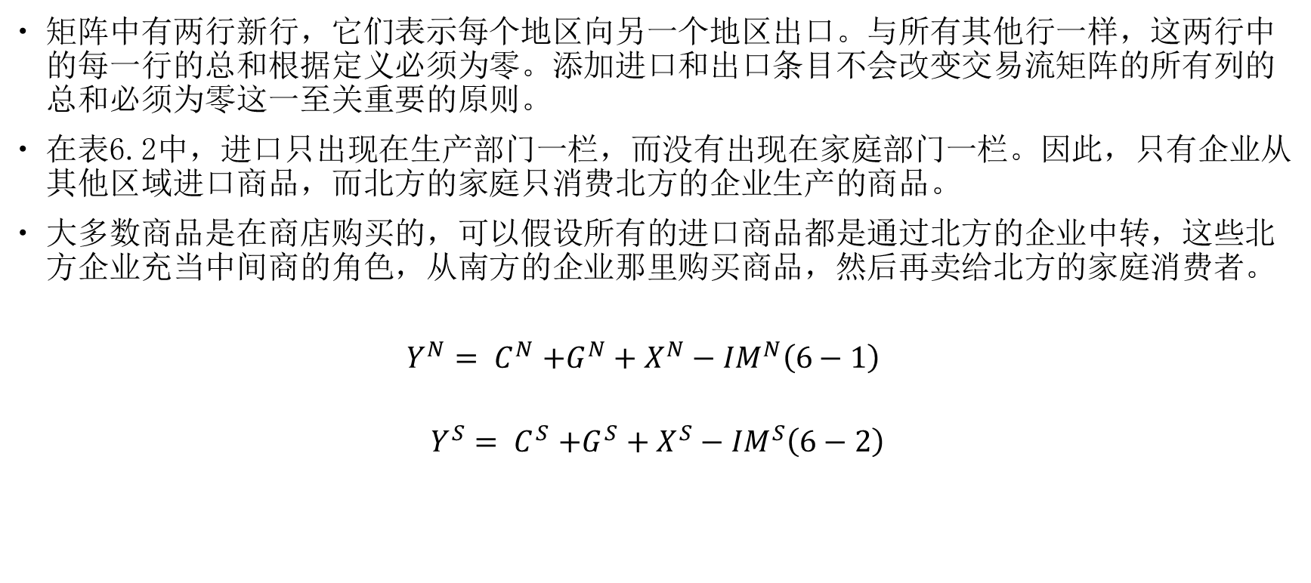
两地区存量—流量一致模型
矩阵中有两行新行，它们表示每个地区向另一个地区出口。与所有其他行一样，这两行中的每一行的总和根据定义必须为零。添加进口和出口条目不会改变交易流矩阵的所有列的总和必须为零这一至关重要的原则。
在表6.2中，进口只出现在生产部门一栏，而没有出现在家庭部门一栏。因此，只有企业从其他区域进口商品，而北方的家庭只消费北方的企业生产的商品。
大多数商品是在商店购买的，可以假设所有的进口商品都是通过北方的企业中转，这些北方企业充当中间商的角色，从南方的企业那里购买商品，然后再卖给北方的家庭消费者。
$$\begin{aligned}Y^{N}{= C}^{N}+G^{N}+X^{N}−{IM}^{N}\#\left(6−1\right)\end{aligned}$$
$$\begin{aligned}Y^{S}{= C}^{S}+G^{S}+X^{S}−{IM}^{S}\#\left(6−2\right)\end{aligned}$$

Slide 91
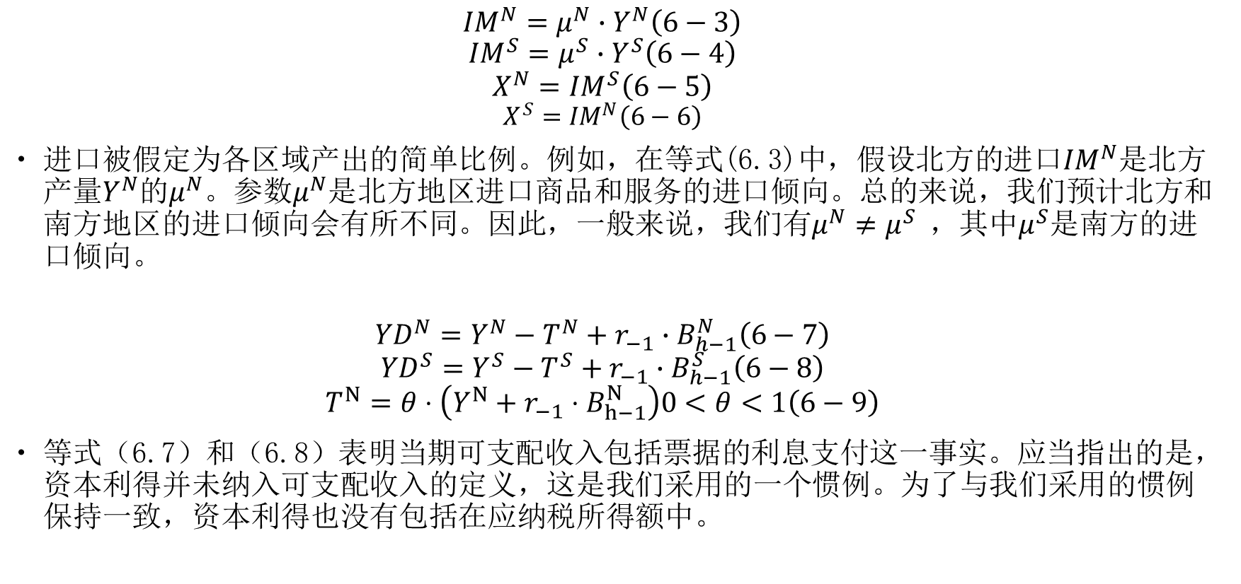
两地区存量—流量一致模型
$$\begin{aligned}{IM}^{N}=μ^{N}∙Y^{N}\#\left(6−3\right)\end{aligned}$$
$$\begin{aligned}{IM}^{S}=μ^{S}∙Y^{S}\#\left(6−4\right)\end{aligned}$$
$$\begin{aligned}X^{N}={IM}^{S}\#\left(6−5\right)\end{aligned}$$
$$\begin{aligned}X^{S}={IM}^{N}\#\left(6−6\right)\end{aligned}$$
进口被假定为各区域产出的简单比例。例如，在等式(6.3)中，假设北方的进口${IM}^{N}$是北方产量$Y^{N}$的$μ^{N}$。参数$μ^{N}$是北方地区进口商品和服务的进口倾向。总的来说，我们预计北方和南方地区的进口倾向会有所不同。因此，一般来说，我们有$μ^{N}≠μ^{S}$ ，其中$μ^{S}$是南方的进口倾向。
$$\begin{aligned}{YD}^{N}=Y^{N}−T^{N}+r_{−1}∙B_{h−1}^{N}\#\left(6−7\right)\end{aligned}$$
$$\begin{aligned}{YD}^{S}=Y^{S}−T^{S}+r_{−1}∙B_{h−1}^{S}\#\left(6−8\right)\end{aligned}$$
$$\begin{aligned}T^{N}=θ⋅\left(Y^{N}+r_{−1}⋅B_{h−1}^{N}\right)0<θ<1\#\left(6−9\right)\end{aligned}$$
等式（6.7）和（6.8）表明当期可支配收入包括票据的利息支付这一事实。应当指出的是，资本利得并未纳入可支配收入的定义，这是我们采用的一个惯例。为了与我们采用的惯例保持一致，资本利得也没有包括在应纳税所得额中。

Slide 92
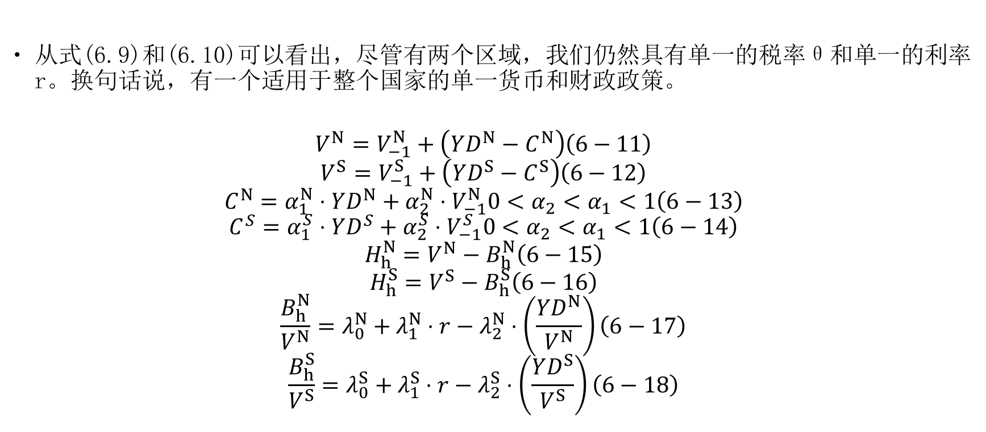
两地区存量—流量一致模型
从式(6.9)和(6.10)可以看出，尽管有两个区域，我们仍然具有单一的税率θ和单一的利率r。换句话说，有一个适用于整个国家的单一货币和财政政策。
$$\begin{aligned}V^{N}=V_{−1}^{N}+\left(YD^{N}−C^{N}\right)\#\left(6−11\right)\end{aligned}$$
$$\begin{aligned}V^{S}=V_{−1}^{S}+\left(YD^{S}−C^{S}\right)\#\left(6−12\right)\end{aligned}$$
$$\begin{aligned}C^{N}=α_{1}^{N}⋅YD^{N}+α_{2}^{N}⋅V_{−1}^{N}0<α_{2}<α_{1}<1\#\left(6−13\right)\end{aligned}$$
$$\begin{aligned}C^{S}=α_{1}^{S}⋅YD^{S}+α_{2}^{S}⋅V_{−1}^{S}0<α_{2}<α_{1}<1\#\left(6−14\right)\end{aligned}$$
$$\begin{aligned}H_{h}^{N}=V^{N}−B_{h}^{N}\#\left(6−15\right)\end{aligned}$$
$$\begin{aligned}H_{h}^{S}=V^{S}−B_{h}^{S}\#\left(6−16\right)\end{aligned}$$
$$\begin{aligned}\frac{B_{h}^{N}}{V^{N}}=λ_{0}^{N}+λ_{1}^{N}⋅r−λ_{2}^{N}⋅\left(\frac{YD^{N}}{V^{N}}\right)\#\left(6−17\right)\end{aligned}$$
$$\begin{aligned}\frac{B_{h}^{S}}{V^{S}}=λ_{0}^{S}+λ_{1}^{S}⋅r−λ_{2}^{S}⋅\left(\frac{YD^{S}}{V^{S}}\right)\#\left(6−18\right)\end{aligned}$$

Slide 93
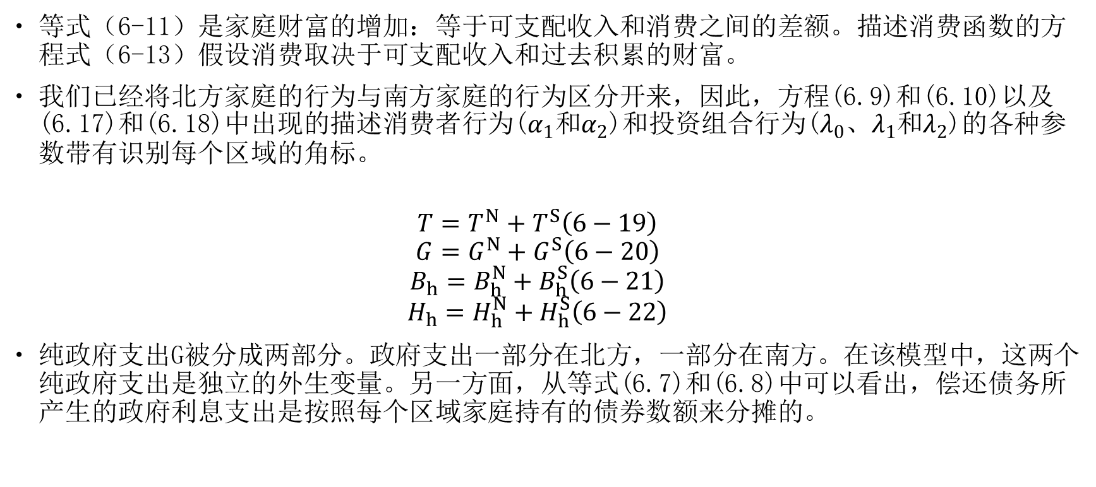
两地区存量—流量一致模型
等式（6-11）是家庭财富的增加：等于可支配收入和消费之间的差额。描述消费函数的方程式（6-13）假设消费取决于可支配收入和过去积累的财富。
我们已经将北方家庭的行为与南方家庭的行为区分开来，因此，方程(6.9)和(6.10)以及(6.17)和(6.18)中出现的描述消费者行为($α_{1}$和$α_{2}$)和投资组合行为($λ_{0}$、$λ_{1}$和$λ_{2}$)的各种参数带有识别每个区域的角标。
$$\begin{aligned}T=T^{N}+T^{S}\#\left(6−19\right)\end{aligned}$$
$$\begin{aligned}G=G^{N}+G^{S}\#\left(6−20\right)\end{aligned}$$
$$\begin{aligned}B_{h}=B_{h}^{N}+B_{h}^{S}\#\left(6−21\right)\end{aligned}$$
$$\begin{aligned}H_{h}=H_{h}^{N}+H_{h}^{S}\#\left(6−22\right)\end{aligned}$$
纯政府支出G被分成两部分。政府支出一部分在北方，一部分在南方。在该模型中，这两个纯政府支出是独立的外生变量。另一方面，从等式(6.7)和(6.8)中可以看出，偿还债务所产生的政府利息支出是按照每个区域家庭持有的债券数额来分摊的。

Slide 94
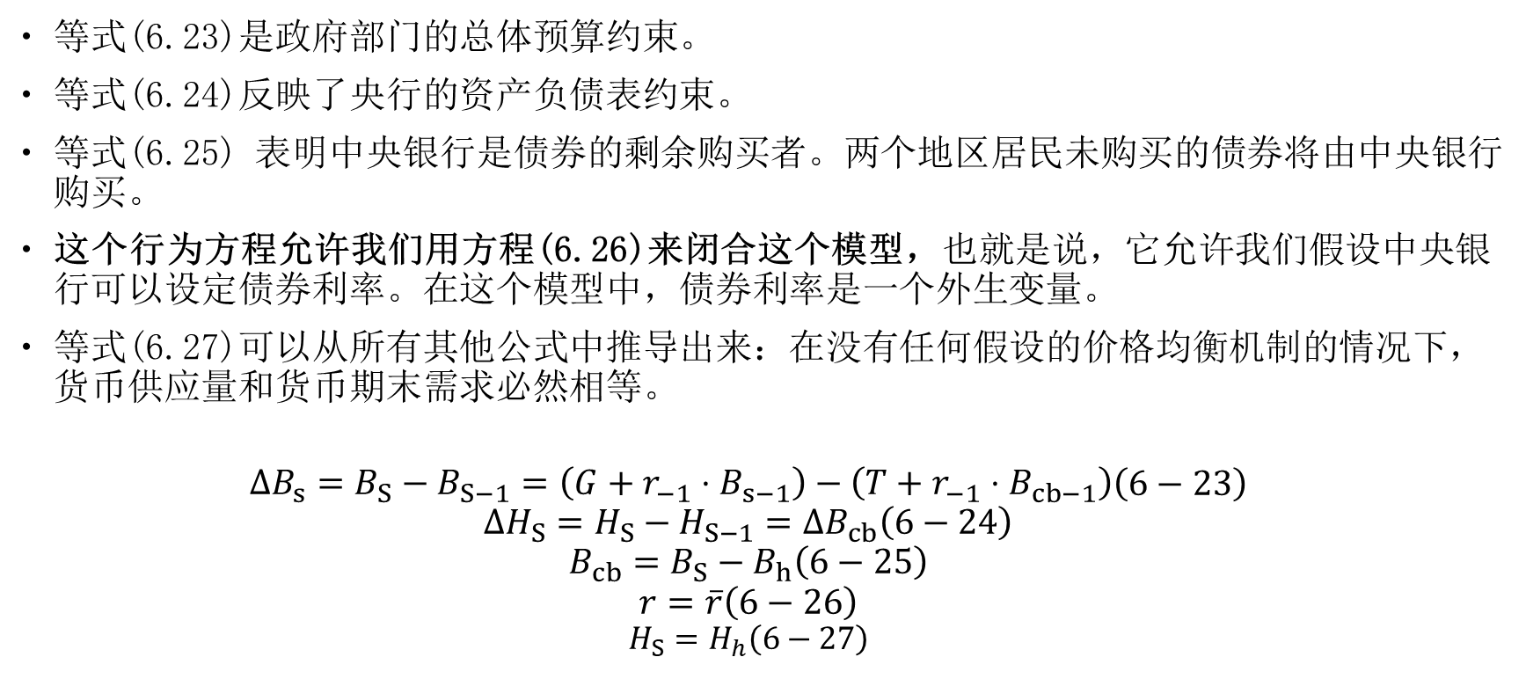
两地区存量—流量一致模型
等式(6.23)是政府部门的总体预算约束。
等式(6.24)反映了央行的资产负债表约束。
等式(6.25) 表明中央银行是债券的剩余购买者。两个地区居民未购买的债券将由中央银行购买。
这个行为方程允许我们用方程(6.26)来闭合这个模型，也就是说，它允许我们假设中央银行可以设定债券利率。在这个模型中，债券利率是一个外生变量。
等式(6.27)可以从所有其他公式中推导出来：在没有任何假设的价格均衡机制的情况下，货币供应量和货币期末需求必然相等。
$$\begin{aligned}\begin{aligned}&ΔB_{s}=B_{S}−B_{S−1}=\left(G+r_{−1}⋅B_{s−1}\right)−\left(T+r_{−1}⋅B_{cb−1}\right)\end{aligned}\#\left(6−23\right)\end{aligned}$$
$$\begin{aligned}ΔH_{S}=H_{S}−H_{S−1}=ΔB_{cb}\#\left(6−24\right)\end{aligned}$$
$$\begin{aligned}B_{cb}=B_{S}−B_{h}\#\left(6−25\right)\end{aligned}$$
$$\begin{aligned}r=\overline{r}\#\left(6−26\right)\end{aligned}$$
$$\begin{aligned}H_{S}=H_{h}\#\left(6−27\right)\end{aligned}$$

Slide 95
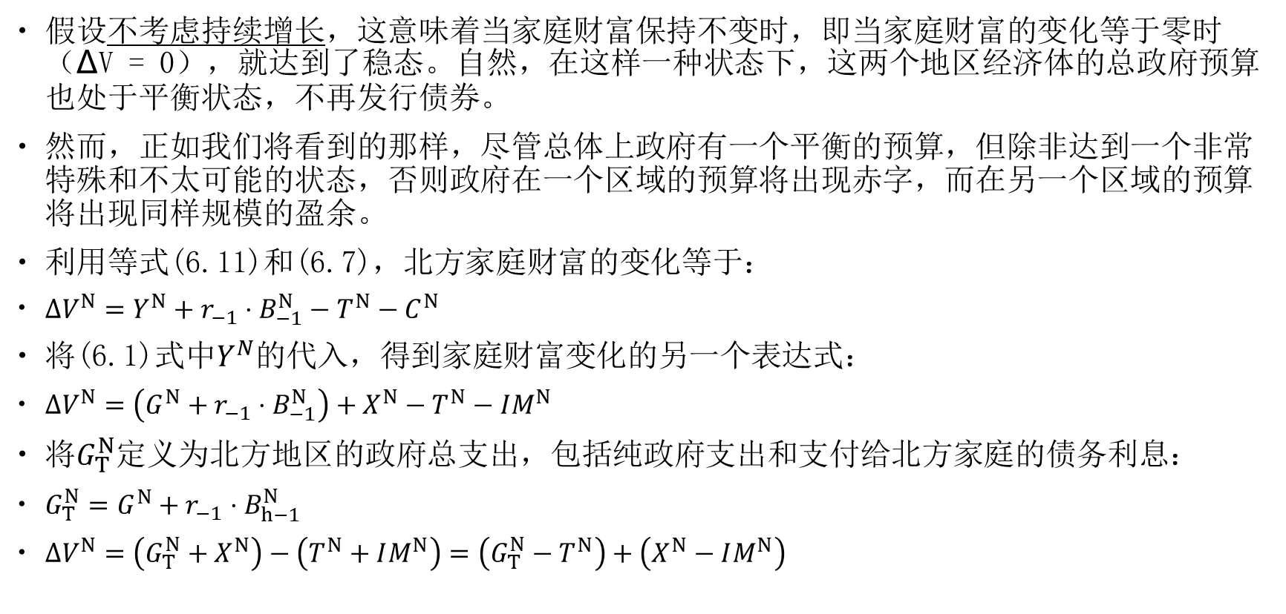
两地区存量—流量一致模型
假设不考虑持续增长，这意味着当家庭财富保持不变时，即当家庭财富的变化等于零时 （∆V = 0），就达到了稳态。自然，在这样一种状态下，这两个地区经济体的总政府预算也处于平衡状态，不再发行债券。
然而，正如我们将看到的那样，尽管总体上政府有一个平衡的预算，但除非达到一个非常特殊和不太可能的状态，否则政府在一个区域的预算将出现赤字，而在另一个区域的预算将出现同样规模的盈余。
利用等式(6.11)和(6.7)，北方家庭财富的变化等于：
$\begin{aligned}ΔV^{N}=Y^{N}+r_{−1}⋅B_{−1}^{N}−T^{N}−C^{N}\#\end{aligned}$
将(6.1)式中$Y^{N}$的代入，得到家庭财富变化的另一个表达式：
$ΔV^{N}=\left(G^{N}+r_{−1}⋅B_{−1}^{N}\right)+X^{N}−T^{N}−IM^{N}$
将$G_{T}^{N}$定义为北方地区的政府总支出，包括纯政府支出和支付给北方家庭的债务利息：
$G_{T}^{N}=G^{N}+r_{−1}⋅B_{h−1}^{N}$
$ΔV^{N}=\left(G_{T}^{N}+X^{N}\right)−\left(T^{N}+IM^{N}\right)=\left(G_{T}^{N}−T^{N}\right)+\left(X^{N}−IM^{N}\right)$

Slide 96
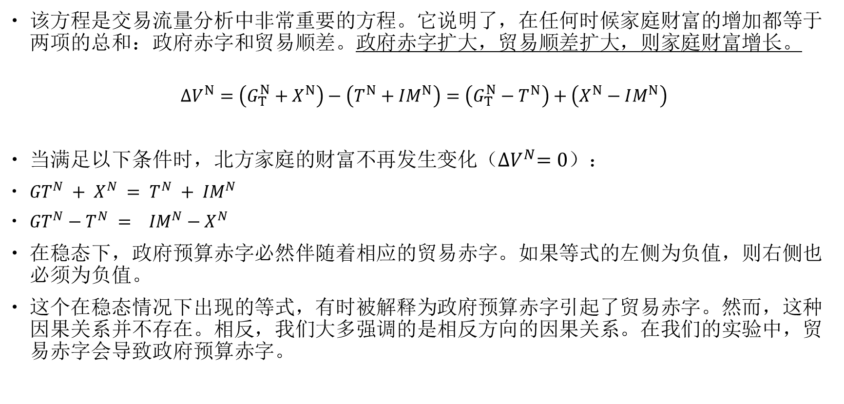
两地区存量—流量一致模型
该方程是交易流量分析中非常重要的方程。它说明了，在任何时候家庭财富的增加都等于两项的总和：政府赤字和贸易顺差。政府赤字扩大，贸易顺差扩大，则家庭财富增长。
$$ΔV^{N}=\left(G_{T}^{N}+X^{N}\right)−\left(T^{N}+IM^{N}\right)=\left(G_{T}^{N}−T^{N}\right)+\left(X^{N}−IM^{N}\right)$$
当满足以下条件时，北方家庭的财富不再发生变化（${∆V}^{N}=0$）：
${GT}^{N} + X^{N} = T^{N} + {IM}^{N}$
${GT}^{N}−T^{N} = {IM}^{N}−X^{N}$
在稳态下，政府预算赤字必然伴随着相应的贸易赤字。如果等式的左侧为负值，则右侧也必须为负值。
这个在稳态情况下出现的等式，有时被解释为政府预算赤字引起了贸易赤字。然而，这种因果关系并不存在。相反，我们大多强调的是相反方向的因果关系。在我们的实验中，贸易赤字会导致政府预算赤字。

Slide 97
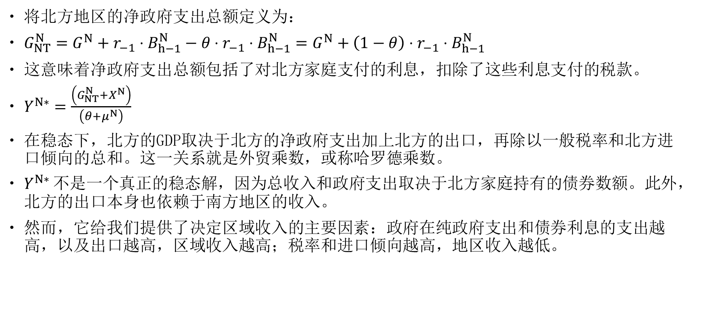
两地区存量—流量一致模型
将北方地区的净政府支出总额定义为：
$G_{NT}^{N}=G^{N}+r_{−1}⋅B_{h−1}^{N}−θ⋅r_{−1}⋅B_{h−1}^{N}=G^{N}+\left(1−θ\right)⋅r_{−1}⋅B_{h−1}^{N}$
这意味着净政府支出总额包括了对北方家庭支付的利息，扣除了这些利息支付的税款。
$Y^{N∗}=\frac{\left(G_{NT}^{N}+X^{N}\right)}{\left(θ+μ^{N}\right)}$
在稳态下，北方的GDP取决于北方的净政府支出加上北方的出口，再除以一般税率和北方进口倾向的总和。这一关系就是外贸乘数，或称哈罗德乘数。
$Y^{N∗}$不是一个真正的稳态解，因为总收入和政府支出取决于北方家庭持有的债券数额。此外，北方的出口本身也依赖于南方地区的收入。
然而，它给我们提供了决定区域收入的主要因素：政府在纯政府支出和债券利息的支出越高，以及出口越高，区域收入越高；税率和进口倾向越高，地区收入越低。

Slide 98
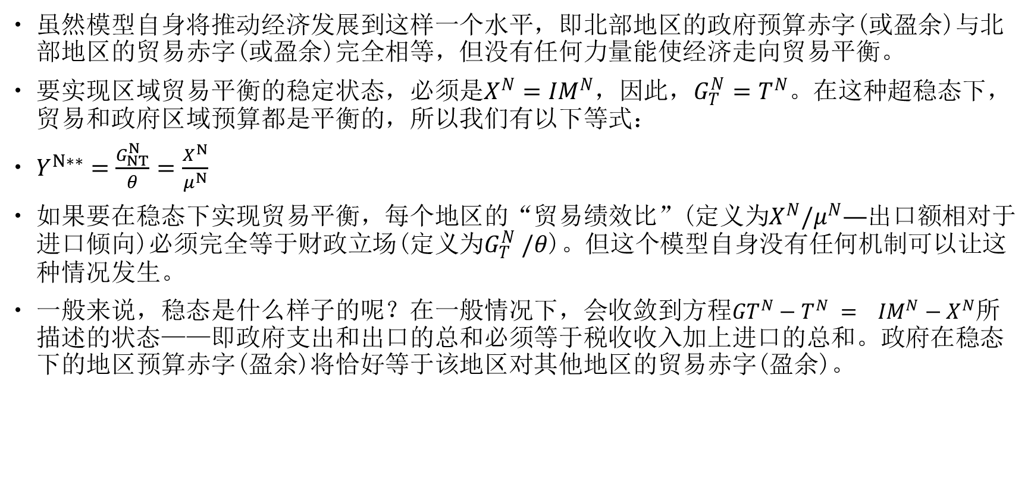
两地区存量—流量一致模型
虽然模型自身将推动经济发展到这样一个水平，即北部地区的政府预算赤字(或盈余)与北部地区的贸易赤字(或盈余)完全相等，但没有任何力量能使经济走向贸易平衡。
要实现区域贸易平衡的稳定状态，必须是$X^{N}={IM}^{N}$，因此，$G_{T}^{N}=T^{N}$。在这种超稳态下，贸易和政府区域预算都是平衡的，所以我们有以下等式：
$Y^{N∗∗}=\frac{G_{NT}^{N}}{θ}=\frac{X^{N}}{μ^{N}}$
如果要在稳态下实现贸易平衡，每个地区的“贸易绩效比”(定义为$X^{N}/μ^{N}—$出口额相对于进口倾向)必须完全等于财政立场(定义为$G_{T}^{N} /θ$)。但这个模型自身没有任何机制可以让这种情况发生。
一般来说，稳态是什么样子的呢？在一般情况下，会收敛到方程${GT}^{N}−T^{N} = {IM}^{N}−X^{N}$所描述的状态——即政府支出和出口的总和必须等于税收收入加上进口的总和。政府在稳态下的地区预算赤字(盈余)将恰好等于该地区对其他地区的贸易赤字(盈余)。

Slide 99
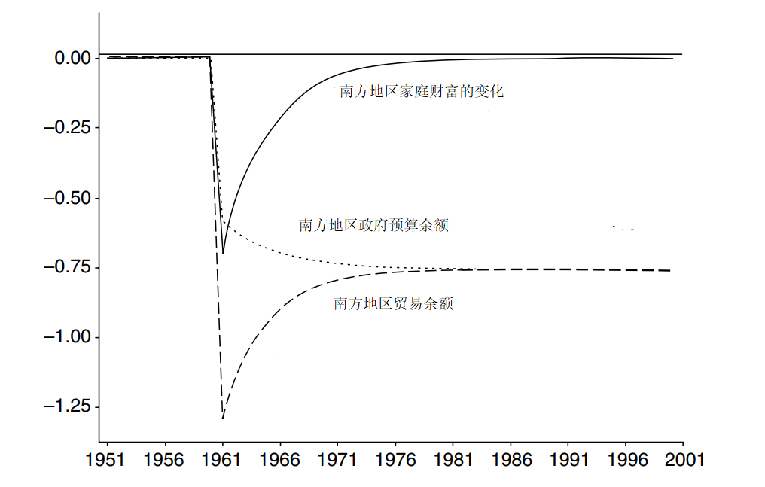
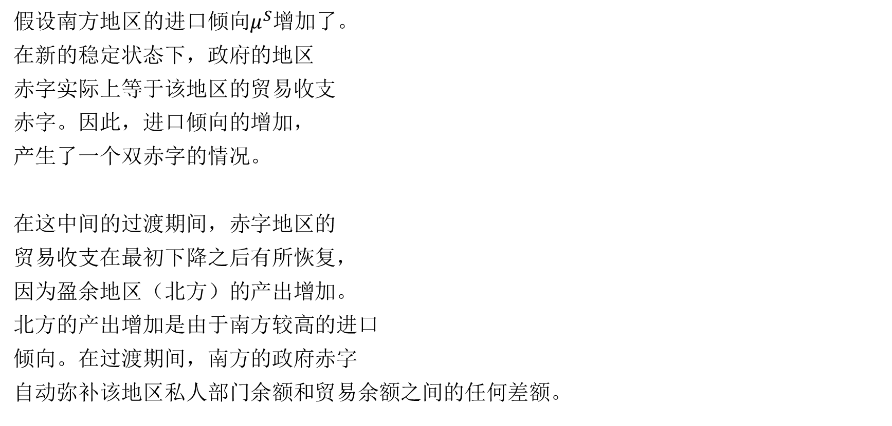
两地区存量—流量一致模型
假设南方地区的进口倾向$μ^{S}$增加了。
在新的稳定状态下，政府的地区
赤字实际上等于该地区的贸易收支
赤字。因此，进口倾向的增加，
产生了一个双赤字的情况。
在这中间的过渡期间，赤字地区的
贸易收支在最初下降之后有所恢复，
因为盈余地区（北方）的产出增加。
北方的产出增加是由于南方较高的进口
倾向。在过渡期间，南方的政府赤字
自动弥补该地区私人部门余额和贸易余额之间的任何差额。
$$ΔV^{N}↓=\left(G_{T}^{N}−T^{N}\right)↑+\left(X^{N}−IM^{N}\right)↓$$
政府赤字扩大，贸易逆差扩大，则家庭财富减少。

Slide 100
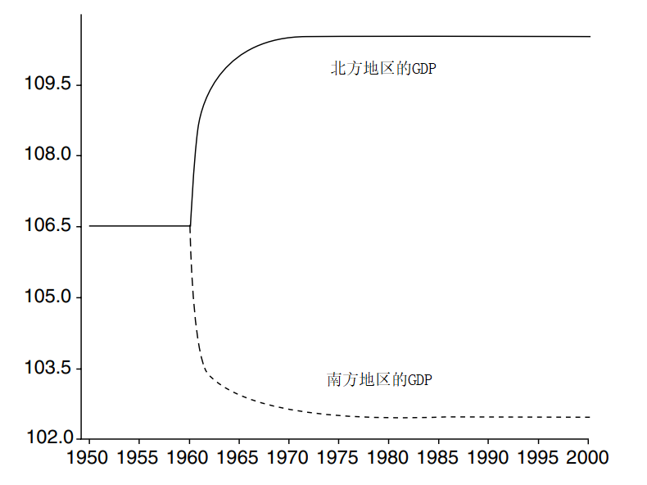
两地区存量—流量一致模型
每个区域的产出演变表明，南方进口倾向的逐步增加导致北方的产出突然增加，而南方的产出则相应减少。然而，这种变化很快就会减弱，因为这个模型包含了每个区域对另一个区域施加的反馈效应。这些反馈效应使一个新的稳态很快就达到，每个区域产生恒定的产出。

Slide 101
两地区存量—流量一致模型
任何一个地区，如果经历了进口倾向的增加，将最终导致地区财政赤字，即使它最初的预算是平衡的。
在稳定状态下，或者更确切地说，在没有增长的稳定状态下，一个国家的两个地区或一个货币联盟的两个国家不可能同时享有政府预算盈余。
这一命题很少被理解，相反，另一个更明显的命题认为，世界上所有国家不能同时享有贸易顺差或国际收支顺差。
尽管所有人都知道，在两个国家组成的货币联盟中，其中一个国家将必然出现贸易赤字，但人们并不总是能够理解，在两个国家组成的货币联盟中，按照会计法则，出现贸易赤字的国家一旦达到稳定状态，也必然会出现政府预算赤字。
尽管在客观上有这种必要性，但欧盟(EMU)仍大力鼓励所有国家实施平衡预算或盈余预算，否则就会受到经济惩罚。这样的规则必须以欧元区成员国相对于世界其他国家出现国际收支盈余为前提。但这一前提是不必然出现的。
欧盟禁止所有国家出现预算赤字的规则在经济上毫无意义。

Slide 102
两地区存量—流量一致模型
预算赤字会导致贸易赤字吗？
从一个预算平衡和贸易平衡的稳态开始，中央政府决定增加南方的政府支出。
这两个区域都将受益于经济活动的增加，但由于其影响在南方更为直接，GDP产出在南方的反应将比在北方更为激烈。
由于收入和可支配收入的增加，南方家庭财富的目标水平会更高，南方家庭在向新稳态过渡期间会储蓄。一旦达到稳定状态，南方会出现的贸易赤字和财政赤字。
政府赤字扩大 大于 贸易逆差扩大，则家庭财富增长。
对称地，北方地区会出现贸易盈余和财政盈余，而且规模相等，因此中央政府的总体预算状况将是平衡的。
$$ΔV^{N}↑=\left(G_{T}^{N}−T^{N}\right)↑+\left(X^{N}−IM^{N}\right)↓$$

Slide 103
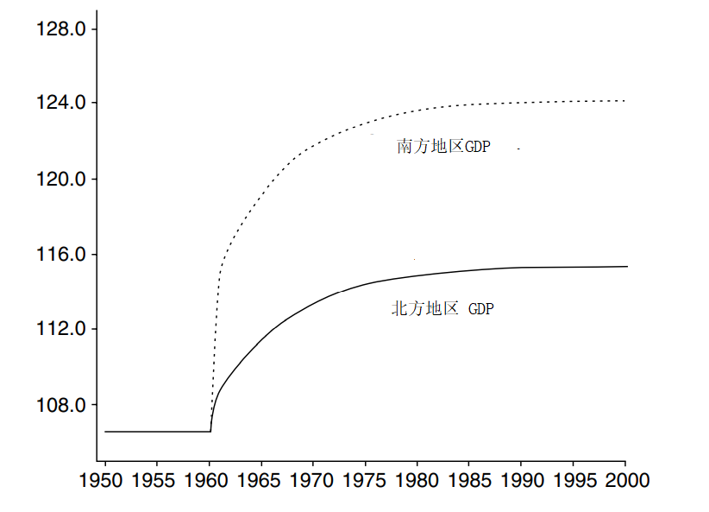
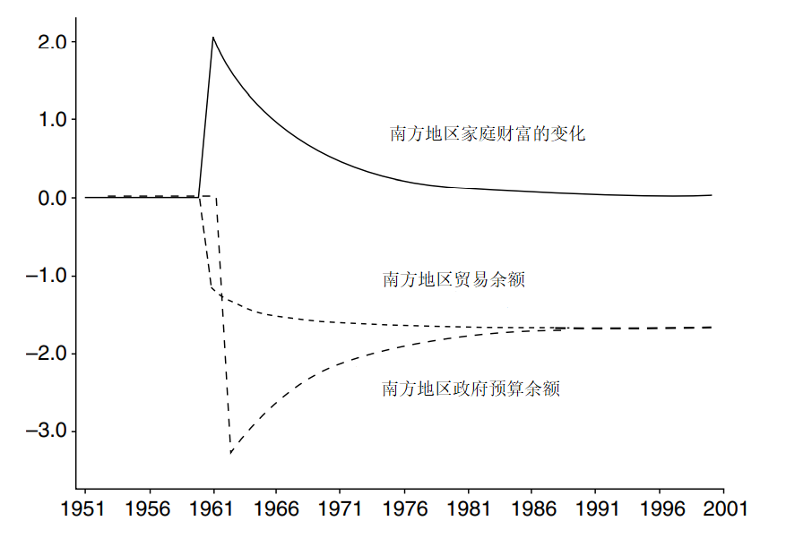
两地区存量—流量一致模型
政府赤字扩大 大于 贸易逆差扩大，则家庭财富增长。

Slide 104
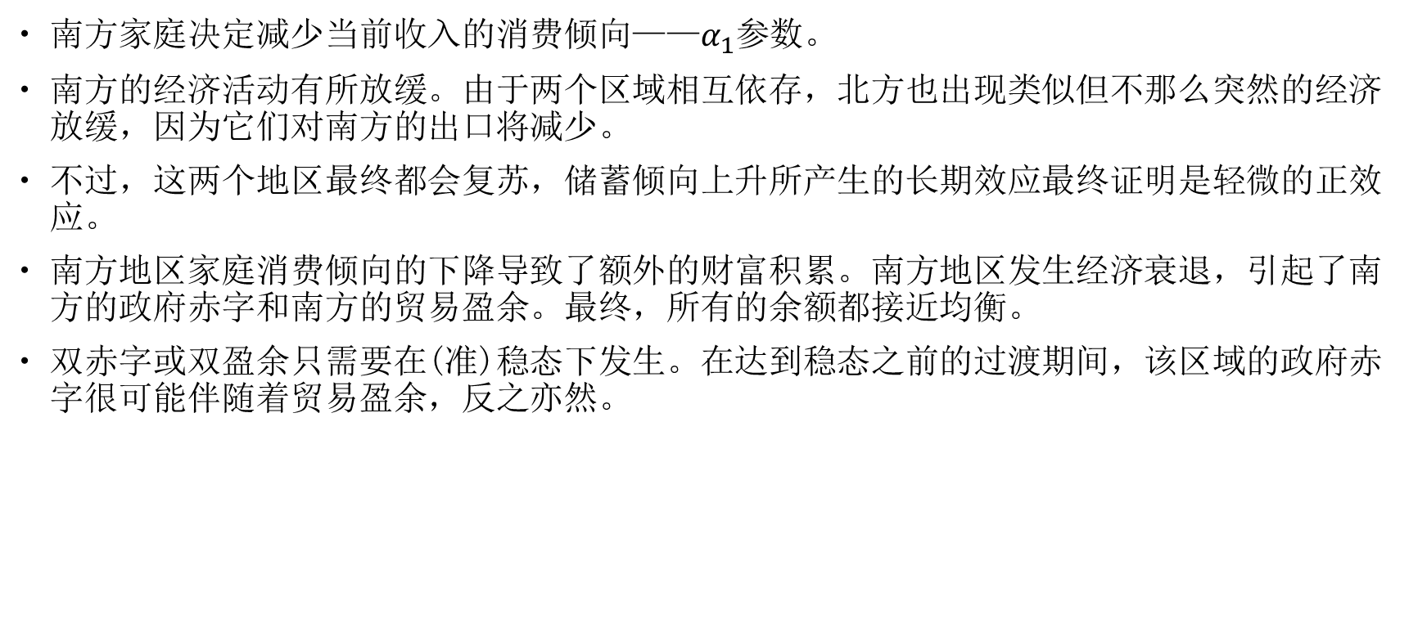
两地区存量—流量一致模型
南方家庭决定减少当前收入的消费倾向——$α_{1}$参数。
南方的经济活动有所放缓。由于两个区域相互依存，北方也出现类似但不那么突然的经济放缓，因为它们对南方的出口将减少。
不过，这两个地区最终都会复苏，储蓄倾向上升所产生的长期效应最终证明是轻微的正效应。
南方地区家庭消费倾向的下降导致了额外的财富积累。南方地区发生经济衰退，引起了南方的政府赤字和南方的贸易盈余。最终，所有的余额都接近均衡。
双赤字或双盈余只需要在(准)稳态下发生。在达到稳态之前的过渡期间，该区域的政府赤字很可能伴随着贸易盈余，反之亦然。

Slide 105
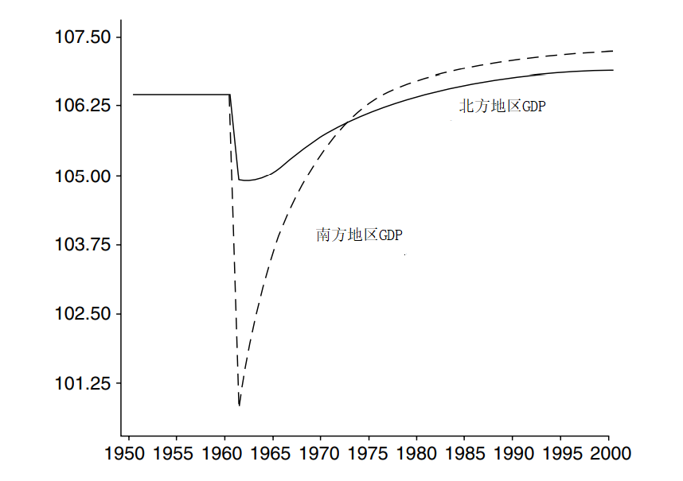
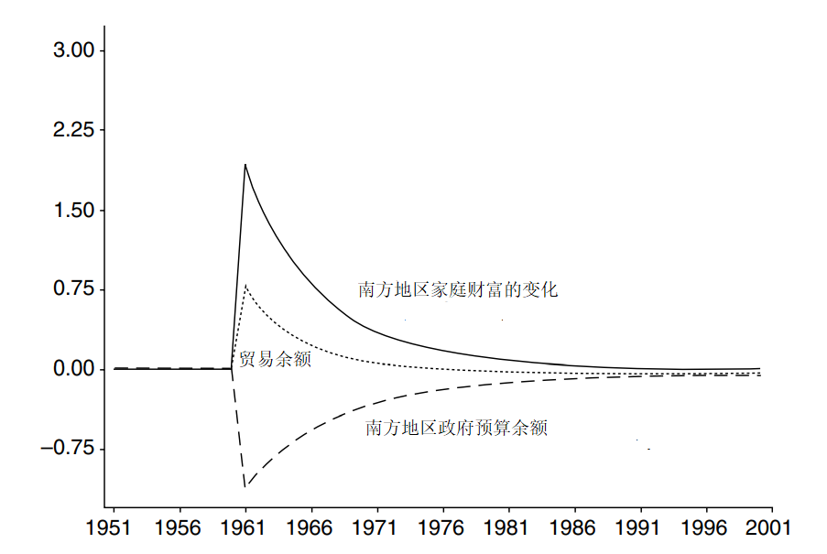
两地区存量—流量一致模型
政府赤字扩大，贸易顺差扩大，则家庭财富增长。

Slide 106
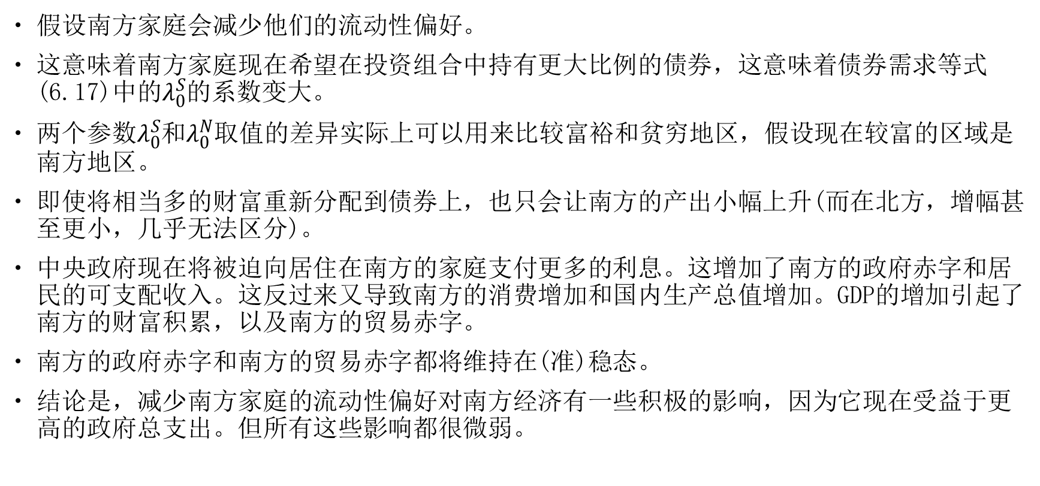
两地区存量—流量一致模型
假设南方家庭会减少他们的流动性偏好。
这意味着南方家庭现在希望在投资组合中持有更大比例的债券，这意味着债券需求等式(6.17)中的$λ_{0}^{S}$的系数变大。
两个参数$λ_{0}^{S}$和$λ_{0}^{N}$取值的差异实际上可以用来比较富裕和贫穷地区，假设现在较富的区域是南方地区。
即使将相当多的财富重新分配到债券上，也只会让南方的产出小幅上升(而在北方，增幅甚至更小，几乎无法区分)。
中央政府现在将被迫向居住在南方的家庭支付更多的利息。这增加了南方的政府赤字和居民的可支配收入。这反过来又导致南方的消费增加和国内生产总值增加。GDP的增加引起了南方的财富积累，以及南方的贸易赤字。
南方的政府赤字和南方的贸易赤字都将维持在(准)稳态。
结论是，减少南方家庭的流动性偏好对南方经济有一些积极的影响，因为它现在受益于更高的政府总支出。但所有这些影响都很微弱。

Slide 107
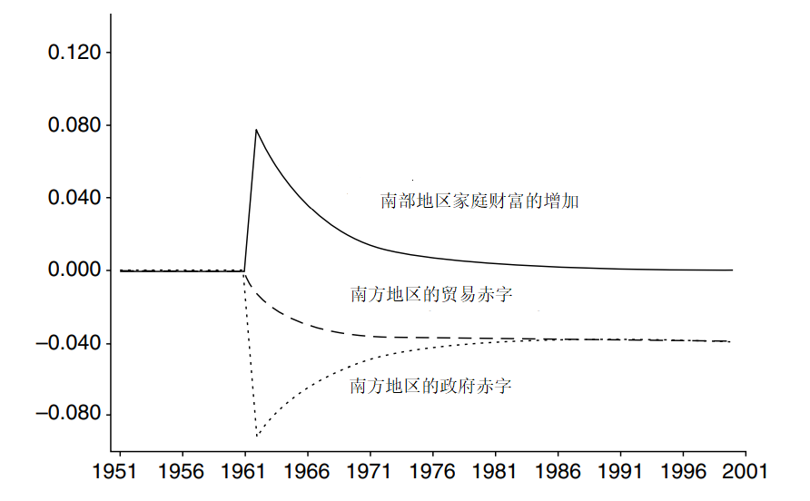
两地区存量—流量一致模型

Slide 108
两国存量—流量一致模型
目前将假定每个国家的私人居民都不允许持有任何类型的外国资产。
假定汇率是固定的，因此在外汇市场上的买卖之间的任何差异都由中央银行的交易弥补。
现在每个国家都有自己的政府发行债券，每个国家都有中央银行发行自己的货币。但除此之外，每个国家的央行都拥有一定数量的黄金储备，它们不属于金融资产，也没有相应的负债。这就是为什么出现在Σ列中的黄金储备值不是零。尽管如此，各国央行的资产净值为零，就像它们在没有黄金储备的前一种模行中那样。
汇率xr：如果北方地区以美元为单位，而南方地区以日元为单位，一美元可以兑换100日元，则汇率xr等于100。
就黄金储备而言，我们必须加上以不同货币计价的黄金储备。北方的黄金储备必须兑换成南方国家的货币，以便北方和南方的黄金储备能够相加。这是通过将北方的黄金储备价值乘以汇率xr来实现的。

Slide 109
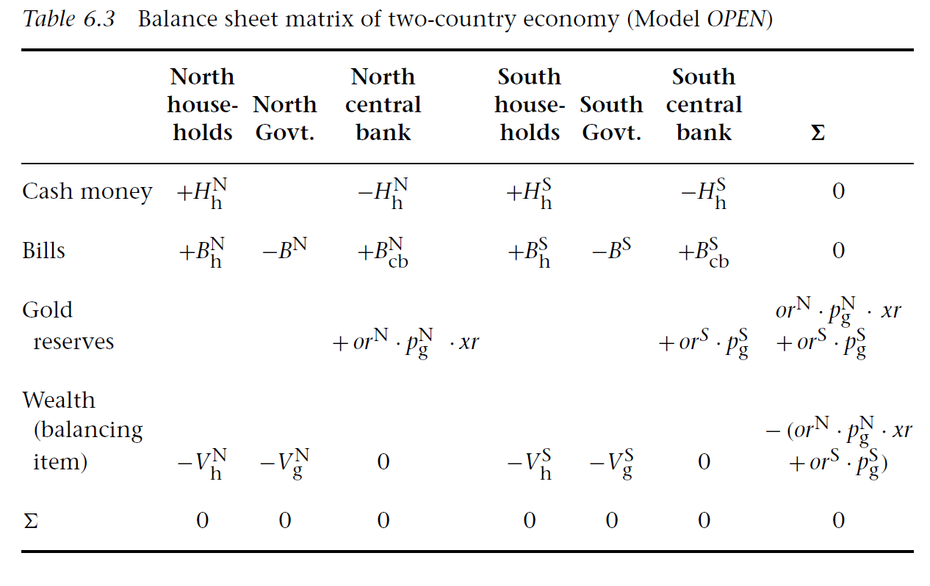
两国存量—流量一致模型

Slide 110
两国存量—流量一致模型
在没有国家间财政转移支付的情况下，必须有一种能够解决国际债务的方法。由于两个国家的居民都不持有另一国的货币，当他们的出口产品收到以外币计价的付款时，他们会将所得款项兑换成本国货币；当他们用外币支付进口产品时，他们必须从中央银行获得外币。
如果私人部门为进口支付的款项超过了从出口收取的款项，那么在涉及两个中央银行的交易中就有了一个完全相同的对应项。
这里假设国际上认可的支付手段指的是——以本国货币为单位按一定固定汇率度量的金条交易。
在固定汇率和没有贸易限制的情况下，每个央行都必须愿意以该固定汇率买卖任何规模的黄金。
在目前的国际货币体系内，金条不再被交易。虽然部分中央银行仍持有黄金储备，但中央银行的储备主要由外国货币组成，主要是美元。每当中央银行决定干预外汇市场，以维持本币对其他货币(通常为美元)或货币篮子的汇率时，便会使用这些外汇储备。

Slide 111
两国存量—流量一致模型
与所有交易流量矩阵一样，表6.4中的每一行和每一列的总和必须为零。
我们在对每一列中的项目进行加总时无需担心所使用的货币，因为所有这些项目都是以本国货币计算的。
将这些行相加有点复杂。与资产负债表的情况一样，许多行都没有问题，因为这些行中的每一半(仅与国内交易相关)总计都为零。
然而，并非所有行都是这种情况，尤其是处理出口行和黄金储备变化的行的情况并非如此。对于这些行，必须引入一个额外的列，将北方国家的价值乘以汇率xr，以获得用南方货币计价的价值。和其他所有行一样，通过汇率调整后，涉及出口和黄金持有量变化的行之和也为零。
出现在描述出口的两行中的贸易流量构成了经常账户上的国际收支，而经常账户上的国际收支又恰好等于“储备变化”一行中描述的每个国家的黄金交易总额。
复式记账的逻辑意味着，最后一行中的分录总和为零；因此，由于“储备变动”一行中的两个条目都是负号，所以一个国家的黄金储备上涨必然对应着另一个国家的黄金储备下跌，且程度相等。

Slide 112
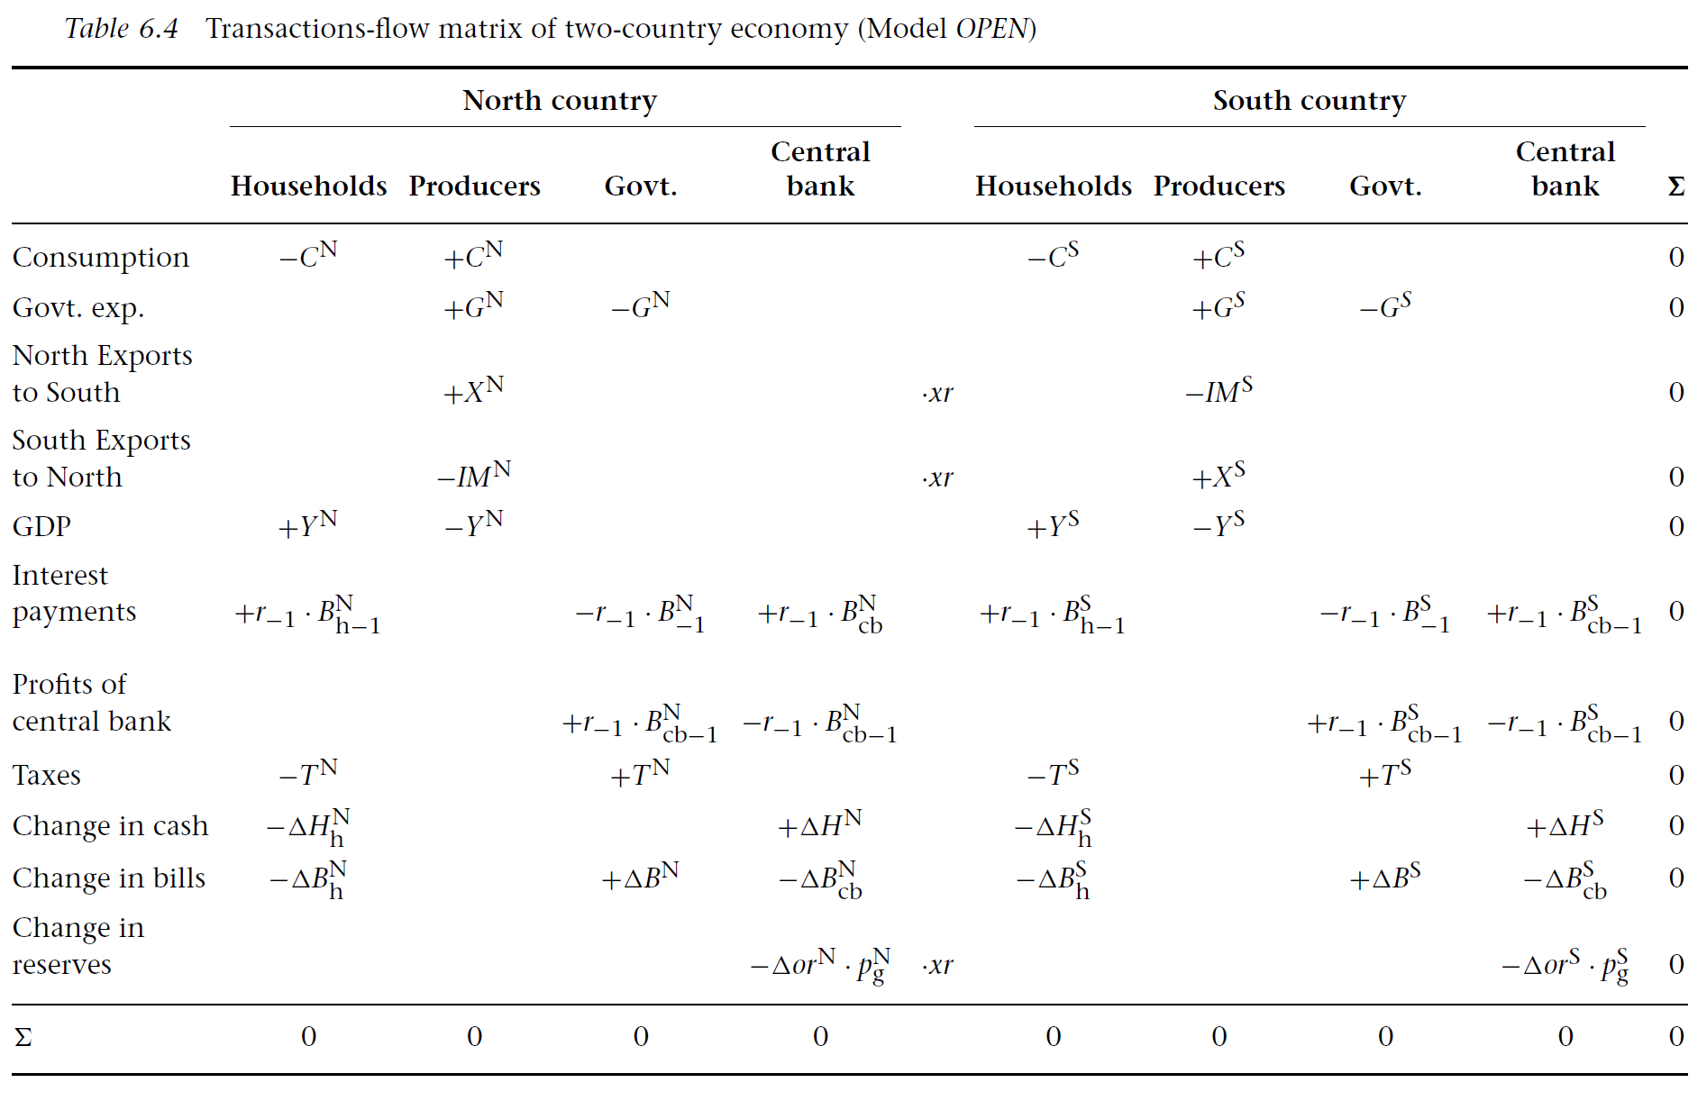
两国存量—流量一致模型

Slide 113
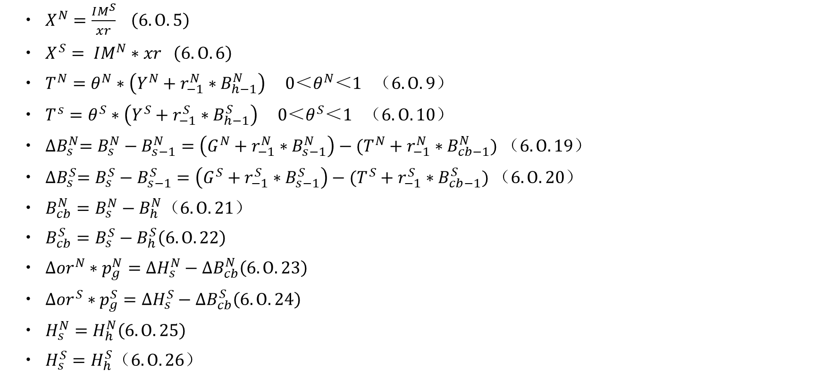
两国存量—流量一致模型
$X^{N}=\frac{IM^{S}}{xr} （6.O.5）$
$X^{S}= IM^{N}∗xr （6.O.6）$
$T^{N}=θ^{N}∗（Y^{N}+r_{−1}^{N}∗B_{h−1}^{N}） 0＜θ^{N}＜1 （6.O.9）$
$T^{s}=θ^{S}∗（Y^{S}+r_{−1}^{S}∗B_{h−1}^{S}） 0＜θ^{S}＜1 （6.O.10）$
${∆B}_{s}^{N}=B_{s}^{N}−B_{s−1}^{N}=\left(G^{N}+r_{−1}^{N}∗B_{s−1}^{N}\right)−(T^{N}+r_{−1}^{N}∗B_{cb−1}^{N}) （6.O.19）$
${∆B}_{s}^{S}=B_{s}^{S}−B_{s−1}^{S}=\left(G^{S}+r_{−1}^{S}∗B_{s−1}^{S}\right)−(T^{S}+r_{−1}^{S}∗B_{cb−1}^{S}) （6.O.20）$
$B_{cb}^{N}=B_{s}^{N}−B_{h}^{N}（6.O.21）$
$B_{cb}^{S}=B_{s}^{S}−B_{h}^{S}（6.O.22）$
$∆{or}^{N}∗p_{g}^{N}={∆H}_{s}^{N}−{∆B}_{cb}^{N}（6.O.23）$
$∆{or}^{S}∗p_{g}^{S}={∆H}_{s}^{S}−{∆B}_{cb}^{S}（6.O.24）$
$H_{s}^{N}=H_{h}^{N}（6.O.25）$
$H_{s}^{S}=H_{h}^{S}（6.O.26）$

Slide 114
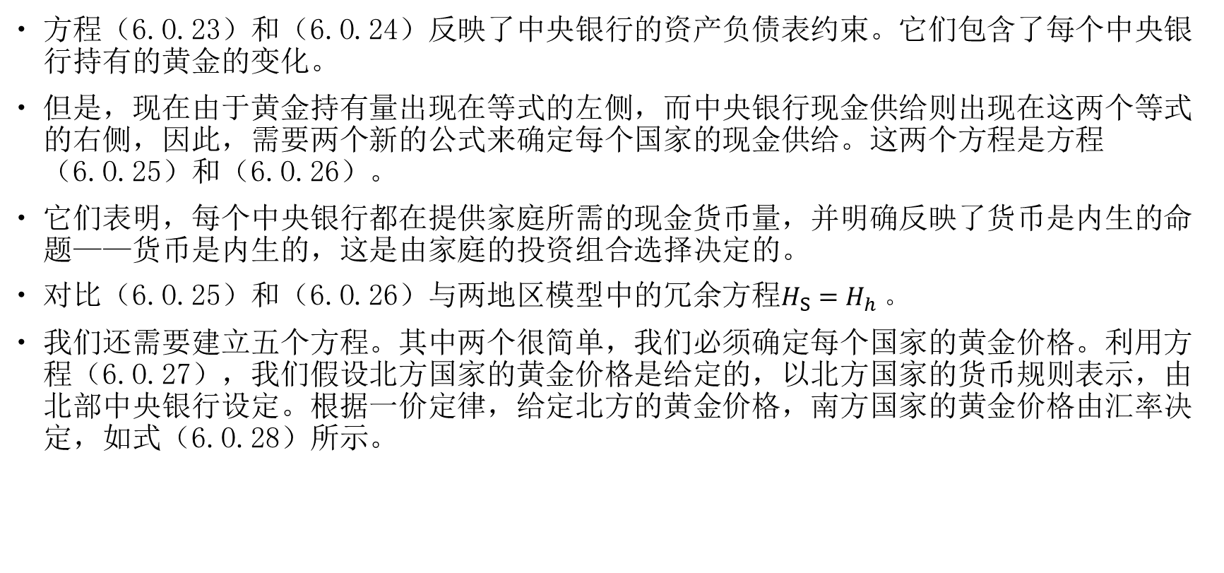
两国存量—流量一致模型
方程（6.O.23）和（6.O.24）反映了中央银行的资产负债表约束。它们包含了每个中央银行持有的黄金的变化。
但是，现在由于黄金持有量出现在等式的左侧，而中央银行现金供给则出现在这两个等式的右侧，因此，需要两个新的公式来确定每个国家的现金供给。这两个方程是方程（6.O.25）和（6.O.26）。
它们表明，每个中央银行都在提供家庭所需的现金货币量，并明确反映了货币是内生的命题——货币是内生的，这是由家庭的投资组合选择决定的。
对比（6.O.25）和（6.O.26）与两地区模型中的冗余方程$H_{S}=H_{h} 。$
我们还需要建立五个方程。其中两个很简单，我们必须确定每个国家的黄金价格。利用方程（6.O.27），我们假设北方国家的黄金价格是给定的，以北方国家的货币规则表示，由北部中央银行设定。根据一价定律，给定北方的黄金价格，南方国家的黄金价格由汇率决定，如式（6.O.28）所示。

Slide 115
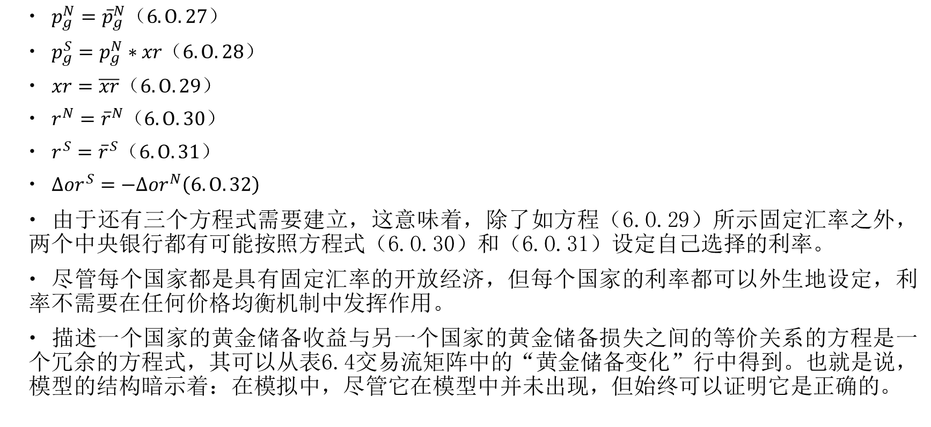
两国存量—流量一致模型
$p_{g}^{N}={\overline{p}}_{g}^{N}（6.O.27）$
$p_{g}^{S}=p_{g}^{N}∗xr（6.O.28）$
$xr=\overline{xr}（6.O.29）$
$r^{N}={\overline{r}}^{N}（6.O.30）$
$r^{S}={\overline{r}}^{S}（6.O.31）$
$∆{or}^{S}=−∆{or}^{N}（6.O.32）$
由于还有三个方程式需要建立，这意味着，除了如方程（6.O.29）所示固定汇率之外，两个中央银行都有可能按照方程式（6.O.30）和（6.O.31）设定自己选择的利率。
尽管每个国家都是具有固定汇率的开放经济，但每个国家的利率都可以外生地设定，利率不需要在任何价格均衡机制中发挥作用。
描述一个国家的黄金储备收益与另一个国家的黄金储备损失之间的等价关系的方程是一个冗余的方程式，其可以从表6.4交易流矩阵中的“黄金储备变化”行中得到。也就是说，模型的结构暗示着：在模拟中，尽管它在模型中并未出现，但始终可以证明它是正确的。

Slide 116
两国存量—流量一致模型
南方国家的进口倾向的增加具有与区域模型有着相同的影响。
两个国家达到一种稳定状态，我们称其为准稳定状态，这时候两国家庭的金融资产（现金和国库券）没有变化，两国的收入水平也没有变化。北方国家的收入现在较高，而南部国家的收入现在较低。
南方国家再次面临了双赤字。
虽然在区域模型中国际收支赤字是由中央政府在区域之间进行的财政转移支付自动弥补的，并且国际收支赤字可以永远持续下去；但在两国模型中，国际收支赤字是由与贸易赤字的数值完全相同的黄金储备损失来弥补的。因为黄金储备的变化是资本账户上唯一的国际间交易（假设没有资本流动）。
在贸易顺差的国家，黄金储备在不断增加，而在贸易逆差的国家，黄金储备不断减少。此外，逆差国家的政府看到其公共债务的规模不断增加，从而面临着公共债务与收入之比上升的情况。
这就是为什么我们称为准稳态的原因，因为某些主要变量或比率仍在变化，并且这种变化不可能无限期地持续下去。

Slide 117
两国存量—流量一致模型
从模拟中发现，除了通过外贸乘数机制减少了南方国家的收入之外，私人部门（消费者）没有收到任何经济出现了问题的信号。然而，中央银行正遭受着不可持续的黄金储备损失。
由于没有国际资本流动，而且假设存在严格的固定汇率制度，政府最终将被迫做以下三件事之一：缩减需求直到国际收支赤字能够消除；向国外借黄金储备；或利用行政权利将进口限制在可以用出口额支付的范围内。
如果采用第一种方式，通过将黄金储蓄的变化设置为零，并使政府支出（或税率）内生化，可以算出一个国家的财政紧缩程度—确保经济必须被紧缩到国际收支为零的程度。
在政府的黄金储备用尽并必须采取严厉的限制性行动之前，家庭部门收到的信号几乎与它在区域模型中得到的信号相同。与区域模型一样，赤字国家遭受收入损失，财富损失和失业增加。唯一的增加的信息是，贸易赤字国政府面临永久性政府财政预算赤字，尽管国民收入保持不变。公共债务与收入之比的上升可能会引导家庭减少持有政府票据。但这本身不能阻止中央银行将利率保持在恒定水平。在（准）稳态下，新的公共债务（新发行的票据）全部由央行购买。中央银行购买的票据的价值完全等于它的黄金储备损失的价值，如等式（6.O.23）和（6.O.24）所示。除此之外，没有任何形式的自动纠正机制来阻止贸易逆差。

Slide 118
蒙代尔-弗莱明模型VS补偿理论
这一发现与固定汇率下的蒙代尔-弗莱明模型不符。
固定汇率下的蒙代尔-弗莱明模型是18世纪大卫·休谟（David Hume）概述的“价格流转学说（price-specie flow）”自动调整机制的现代扩展。
这些理论的中心论点是，即使名义汇率固定，只要出现盈余或赤字，就会有一些自动纠正机制逐渐使国际收支平衡恢复平衡。自动纠正机制通常带有以下观点：金本位时代的固定汇率制度下，国际收支赤字意味着黄金储备的损失。这被认为会导致价格水平的下降，使赤字国家的产品更具竞争力（从而增加出口），因此可以恢复国际贸易平衡。
蒙德尔-弗莱明模型的支持者声称，这种（出现在中央银行资产负债表的资产侧）黄金储备的损失会导致（构成了中央银行的负债方的）基础货币的等价减少。基础货币的下降（也就是高能货币供应的下降）导致了货币供应的下降，从而导致利率上升。在国际收支恢复平衡之前，利率将继续上升，只要不恢复外部的贸易平衡，基础货币就会不断下降。这就是现代信用货币体系中的自动纠正机制。

Slide 119
蒙代尔-弗莱明模型VS补偿理论
两国模型的有趣之处在于，尽管贸易赤字国家失去了黄金储备，但这种损失对其他任何变量都没有独立的影响。
两国模型保留了金本位制下汇率的主要特征，这种特征提供了最有利于自动纠正机制运作的制度背景——即国际收支赤字将导致基础货币和货币供应量下降，以及利率的上升，从而使得的国际贸易收支的外部平衡恢复。
两国模型在金本位制下运行，因为任何贸易赤字都必须通过中央银行之间的黄金转移来弥补。尽管如此，两国模型中没有消除国际收支赤字的自动纠正机制。
蒙代尔-弗莱明模型没有考虑到的关键点是：当黄金储备流失时，随着家庭部门在起初的调整过程之后，政府预算赤字将恰好等于这种黄金储备的损失。（家庭）资产存量调整为新的较低水平，以适应较低的收入，但此后它们完全没有变化。
因此，预算赤字的补偿机制消除了黄金储备损失本应对货币体系带来的影响。

Slide 120
蒙代尔-弗莱明模型VS补偿理论
尽管央行没有因为储备损失而刻意“冲销”，但外汇储备的下降却被央行持有的票据数量的增加不断补偿。这种（央行增加国库券的）增长完全是内生的。可以说这是中央银行决定保持票据利率不变的结果。
新的稳态下，货币供应的相对恒定性并不是央行为了保持货币供应恒定而做出的相机抉择的结果（“冲销”）。
北方国家也出现了非常类似的过程，该国凭借其贸易顺差，其外汇储备在不断增加。这些储备的增加被北方国家中央银行需要持有的票据数量减少所抵消。这就是所谓的补偿论点（Lavoie 2001）。
补偿原则认为，外汇储备的变化通常将由内生机制来补偿，这个内生机制来自于中央银行的常规行为和经济中其他经济主体的行为。补偿原则在具有私人货币的开放经济中也适用。

Slide 121
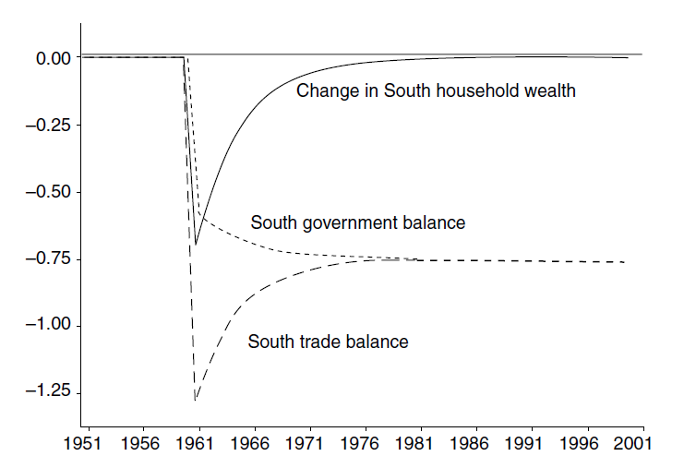
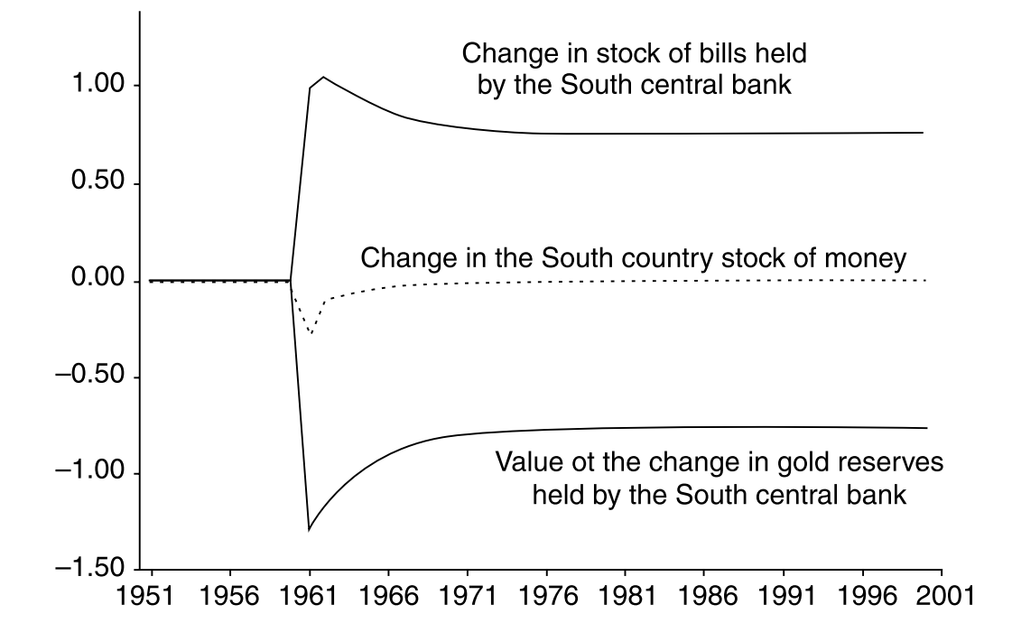
蒙代尔-弗莱明模型VS补偿理论

Slide 122
蒙代尔-弗莱明模型VS补偿理论
主流经济学家通常认为在采用固定汇率的开放经济情况下，货币供应是内生的。相反，其他时候则认为货币供给是一个外生变量。然而，这种货币供应的内生性例子与后凯恩斯主义的货币内生无关。
在蒙代尔-弗莱明模型中，货币供应在固定汇率的情况下被认为是内生的，但是这种内生性过程是由供应主导的。那里的货币存量下降或上升，是因为外汇储备的数量下降或上升。这种货币供应量与家庭的货币需求无关。
在后凯恩斯主义模型中，货币供应是内生的，因为它是由需求主导的。
在两国模型中，货币供应量增长（或减少）是因为家庭需要更多（或更少）的货币。当家庭希望获得更多现金时，中央银行将被动的提供现金。在给定的利率下，金融资产是按需求提供的。
模型中方程式和未知变量数目决定了，除了被动满足所有金融资产需求外，没有其他方法可以描述（净）金融资产供给。

Slide 123
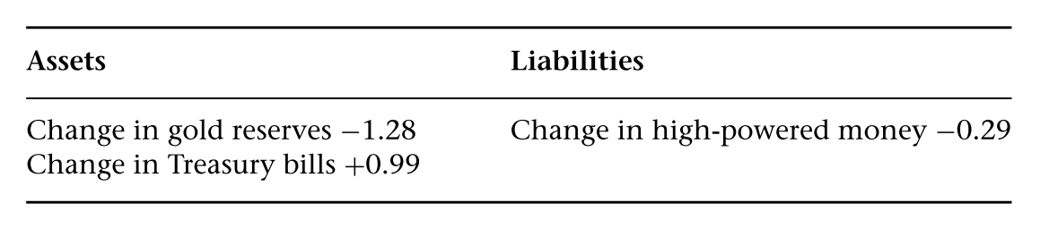
蒙代尔-弗莱明模型VS补偿理论
赤字国家的情况乍一看似乎证明了蒙代尔-弗莱明的故事。从外部平衡和平衡预算开始，进口倾向的增加导致国际收支赤字，并且在过渡期的初期也导致现金存量下降，如同Mundell-Fleming模型所预测的那样。
下表所示是进口猛增对南方中央银行资产负债表的第一期影响，导致的货币存量下降（-0.29）远小于黄金储备的下降（-1.28）；实际上，它大约小了五倍。
差异由中央银行持有的国库券增加（+0.99）补偿。

Slide 124
蒙代尔-弗莱明模型VS补偿理论
这是因为货币存量的下降不是由黄金储备的减少引起的，而是完全由需求减少决定的。
这是由于较高的进口倾向导致收入流量（flow of income）减少的结果。进而引起收入水平（level of income）的下降，并导致目标财富（target level of wealth）水平的下降，从而导致期望的现金余额下降。
为了实现这一较低的财富目标，家庭减少了储蓄。但这些影响只是暂时的。一段时间后，当收入和财富达到新的稳定水平时，家庭持有的货币数量将保持不变，然而贸易赤字仍将保持不变，中央银行的黄金储备将不断消耗。
只要认识到货币供应是信贷驱动和需求决定的，汇率制度就绝对不会对货币和信贷的决定产生任何影响。
利率可以由中央银行设定，而货币在这种固定汇率制度下是由需求决定的。

Slide 125
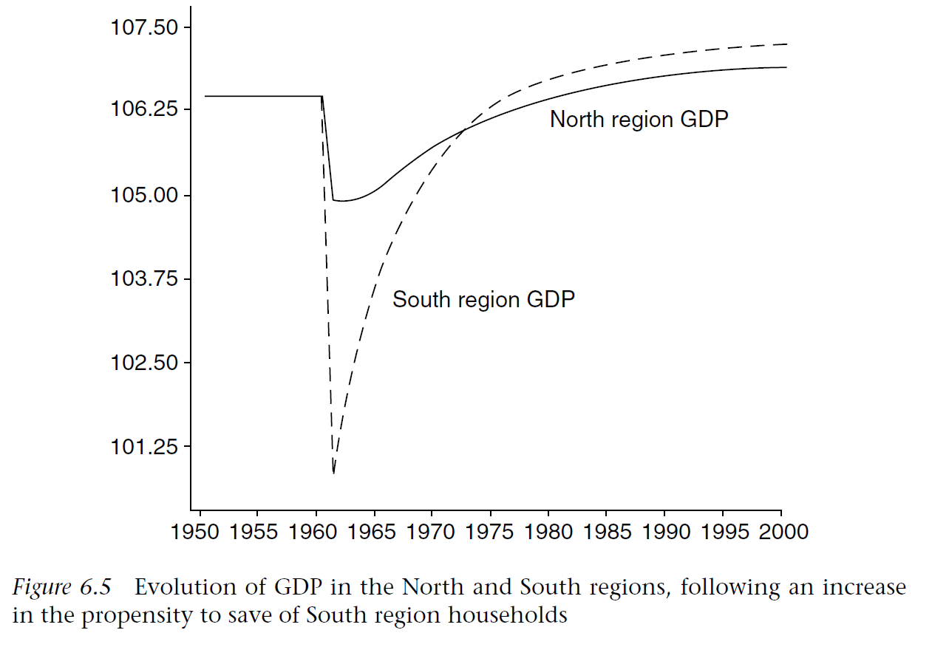
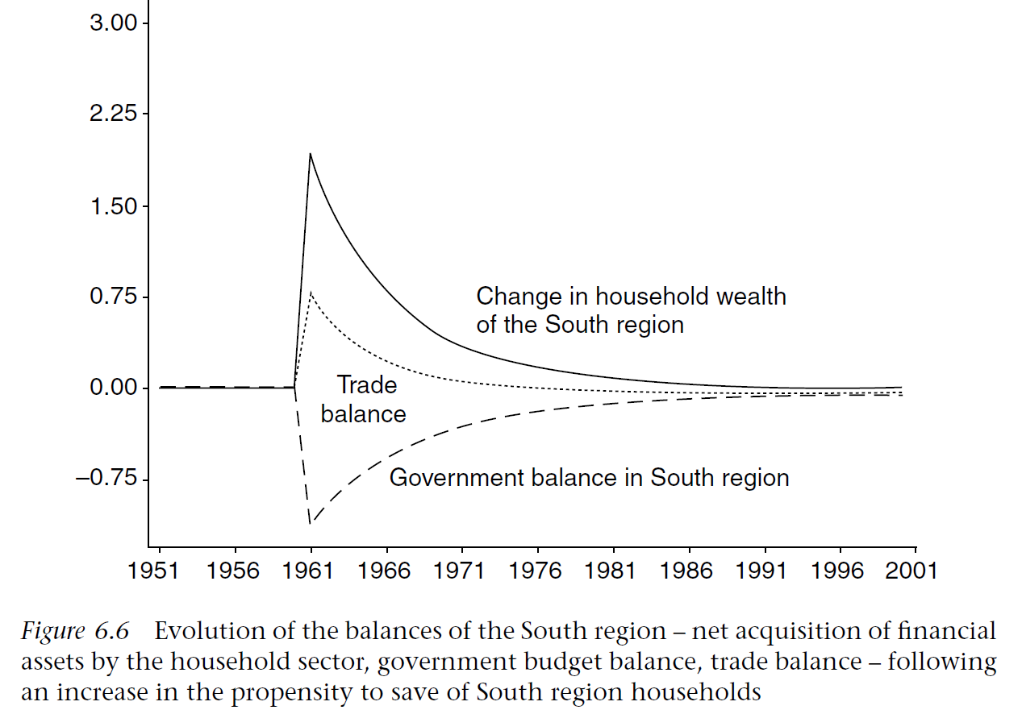
蒙代尔-弗莱明模型VS补偿理论
假设南方家庭决定增加他们的储蓄倾向，从而增加他们的目标财富与收入之比。这项决定对GDP的影响与两个地区的情况相同，南方和北方国家的GDP均迅速下降，但在新的稳态，GDP得到恢复并上升到比原来稍高的水平。
同样，对南方家庭财富余额，贸易余额和政府预算的影响与两个地区的情况相同。换句话说，南方的短期衰退最初会产生政府赤字和贸易顺差。但是，从长期来看，这种贸易顺差会逆转，因为南方较高的稳态GDP会产生恒定的贸易赤字和与贸易赤字等量的政府赤字。

Slide 126
蒙代尔-弗莱明模型VS补偿理论
两国模型的新结果：该图说明了南方中央银行资产负债表的三个组成部分发生了什么变化。
黄金持有量的演变反映了贸易余额的演变。最初黄金持有量增加，但是由于达到了准稳态且贸易赤字恒定，所以黄金逐渐外流。
高能货币的存量最初增加，反映了南方家庭所需财富的增加，然后保持不变，反映了准稳态下家庭财富没有变化。
至于中央银行持有的国库券，正是中央银行的这一部分根据其资产负债表其他部分的波动进行了调整。
为了维持给定的利率，南方中央银行通过增加国内信贷，即通过增加其持有的国库券来补偿准稳态的黄金储备流出。
对比之下，在经济衰退期间，黄金流入，同时由于南方家庭决定增加其财富而导致的货币供应量的适度增加，通过央行减少国库券而得到了补偿。再次说明了补偿原则。

Slide 127

蒙代尔-弗莱明模型VS补偿理论

Slide 128

调整机制
两国模型的结果表明：没有自动的机制会推动一国达到贸易平衡。这一结论成立的前提是一国有剩余的外汇储备。
然而，当一个国际收支赤字的国家黄金储备不足时，政府必须采取一些措施。赤字国家的政府可以决定采取财政紧缩措施，以通过减少国民收入和进口来建立贸易平衡。由于存在双赤字问题，这种决定尤其可能发生：具有贸易赤字的国家至少在达到稳定状态时也将面临政府预算赤字。
任何开放经济的长期增长率基本上都受一个比率的约束。这个比例是该开放经济的出口增长率除以该国进口的收入弹性。
$Y^{N}=\frac{G_{NT}^{N}}{θ^{N}}=\frac{X^{N}}{μ^{N}}$
假设出口是外生的，并且进口的倾向无法改变，那么对于一个贸易逆差的国家来说（ $\frac{G_{NT}^{N}}{θ^{N}}>\frac{X^{N}}{μ^{N}}$），达到超级稳态的唯一途径是减少纯政府支出或提高税率。

Slide 129

调整机制
如果南方国家确实采取这样的政策，显然世界经济将遭受衰退，因为南方国家自主支出的减少最终会导致北方国家的出口的减少。
然而，对于有贸易顺差和预算盈余的国家，几乎没有动力来提高纯政府支出，因此，作用力是不对称的。
考虑通过纯政府支出的变化进行调整的可能性：首先对非对称的调整机制进行建模，它会在黄金储备减少时导致纯政府支出减少，而在黄金储备增加时导致纯政府支出较少量增长：
$G^{N}=G_{−1}^{N}+φ^{N}⋅\left(Δor_{−1}^{N}⋅p_{g−1}^{N}\right)$
$G^{S}=G_{−1}^{S}+φ^{S}⋅\left(Δor_{−1}^{S}⋅p_{g−1}^{S}\right)$
从超级稳定状态开始，南方国家的进口倾向有所增加。随着净出口减少，南方经济放缓，必须面对黄金储备流失和政府赤字。
但是，在这一次，黄金损失和预算赤字不会永远持续下去，因为纯政府支出的减少使经济放缓，并使经济回到贸易平衡和预算平衡。

Slide 130


调整机制
这种稳定机制的唯一问题是经济必然减缓，在新的稳态下，赤字国家的收入水平低于纯政府支出保持不变下应有的水平。
在北方经济中，情况恰恰相反：由于贸易状况的改善和政府支出的增加，收入水平提高了。如果北方不通过增加政府支出对其贸易顺差做出反应，南方的收入将进一步下降，但仍将实现贸易平衡。

Slide 131

调整机制
在标准的世界银行调整方案中，较高的利率是为了减缓经济增长，以帮助解决贸易逆差，它们旨在吸引外国资本并促使国内资产持有人继续投资他们在国内金融市场上的资产。
在目前的模型中，很明显加息是没有用的。有两个原因。在此模型中，私人经济活动不取决于利率。此外，排除了国家之间的资本流动。
但是，如果利率对黄金储备的变化做出反应会怎样？可以提出一个与上面提出的方程式相似的调整方程式：
$r^{N}=r_{−1}^{N}−φ^{N}⋅\left(Δor_{−1}^{N}{⋅p}_{−1}^{N}\right)$
$r^{S}=r_{−1}^{S}−φ^{S}⋅\left(Δor_{−1}^{S}{⋅p}_{−1}^{S}\right)$
显然，利率的变化应该是黄金储备变化的负函数。黄金储备的减少应导致利率上升。
似乎已经回到了蒙代尔-弗莱明自动调整机制。如前所述，只要黄金储备下降，蒙代尔-弗莱明自动调整机制都会导致利率自发增加。但是，上述方程式并没有自动或自发的关系。它们是反应方程，需要中央银行相机抉择并采取有目的的行动。利率上升不是由于某些自发的市场调整机制，而是由于货币当局的有意政策选择所致。

Slide 132
调整机制
另一个关键问题是，每当出现贸易逆差时，这种利率上升是否会产生稳定作用。事实证明，这种调整机制从根本上说是不稳定的。
正如模拟迅速揭示的那样，它在形式上是不稳定的。是因为南方的利率上升得越来越快（而北方的利率在不对称规则的基础上不断下降，下降得更慢）。
南方和北方之间的贸易失衡只会加剧，而南方的政府赤字会越来越严重。当确定此类货币调整规则时，该模型将崩溃。
原因：
高利率无法吸引外国资本，因为假设中已排除了资本流动。高利率也不会减缓经济增长，因此也无法减少贸易逆差，因为利率不会对经济产生任何负面影响。
由于公式（6.O.3）和（6.O.7），利率上升使政府的预算赤字恶化（r增加—利息支出增加，G支出增加），并刺激了消费支出（r增加—YD增加——c增加）和经济的进口，导致贸易差额进一步恶化。

Slide 133


调整机制

Slide 134



调整机制
如果让利率对总消费产生负面影响，这种利率调整的不稳定性仍然会发生。例如，假设较高的利率导致较低的可支配收入消费倾向。就南方经济而言$α_{1}^{s}=α_{10}^{s}−t^{s}⋅r^{s}$
该模型变得相当混乱，结果从一组参数到另一组参数变化很大。有时模型会发散，有时会收敛到准稳态。即使短期内较高的利率会使经济放缓，通过利率进行的调整似乎也不可靠。

